Slide 1
Visit https://bit.ly/ds-dojo-2024 for material
データ サイエンティスト
DOJO
Jonathan Soma
js4571@columbia.edu
Knight Chair in Data Journalism, Columbia University

Slide 2

About me
Professor in Data Journalism at Columbia Graduate School of Journalism
Studied Cognitive Science @ UVA
Almost computer science…but no!
Machine Learning and AI @ Columbia
Worked for New York Times, ProPublica, founded a data news team at the nation’s largest radio station
Non-traditional path into journalism and academia (web development, design, education)

Slide 3
why are you learning from a data journalist?
it’s a very good question.

Slide 4
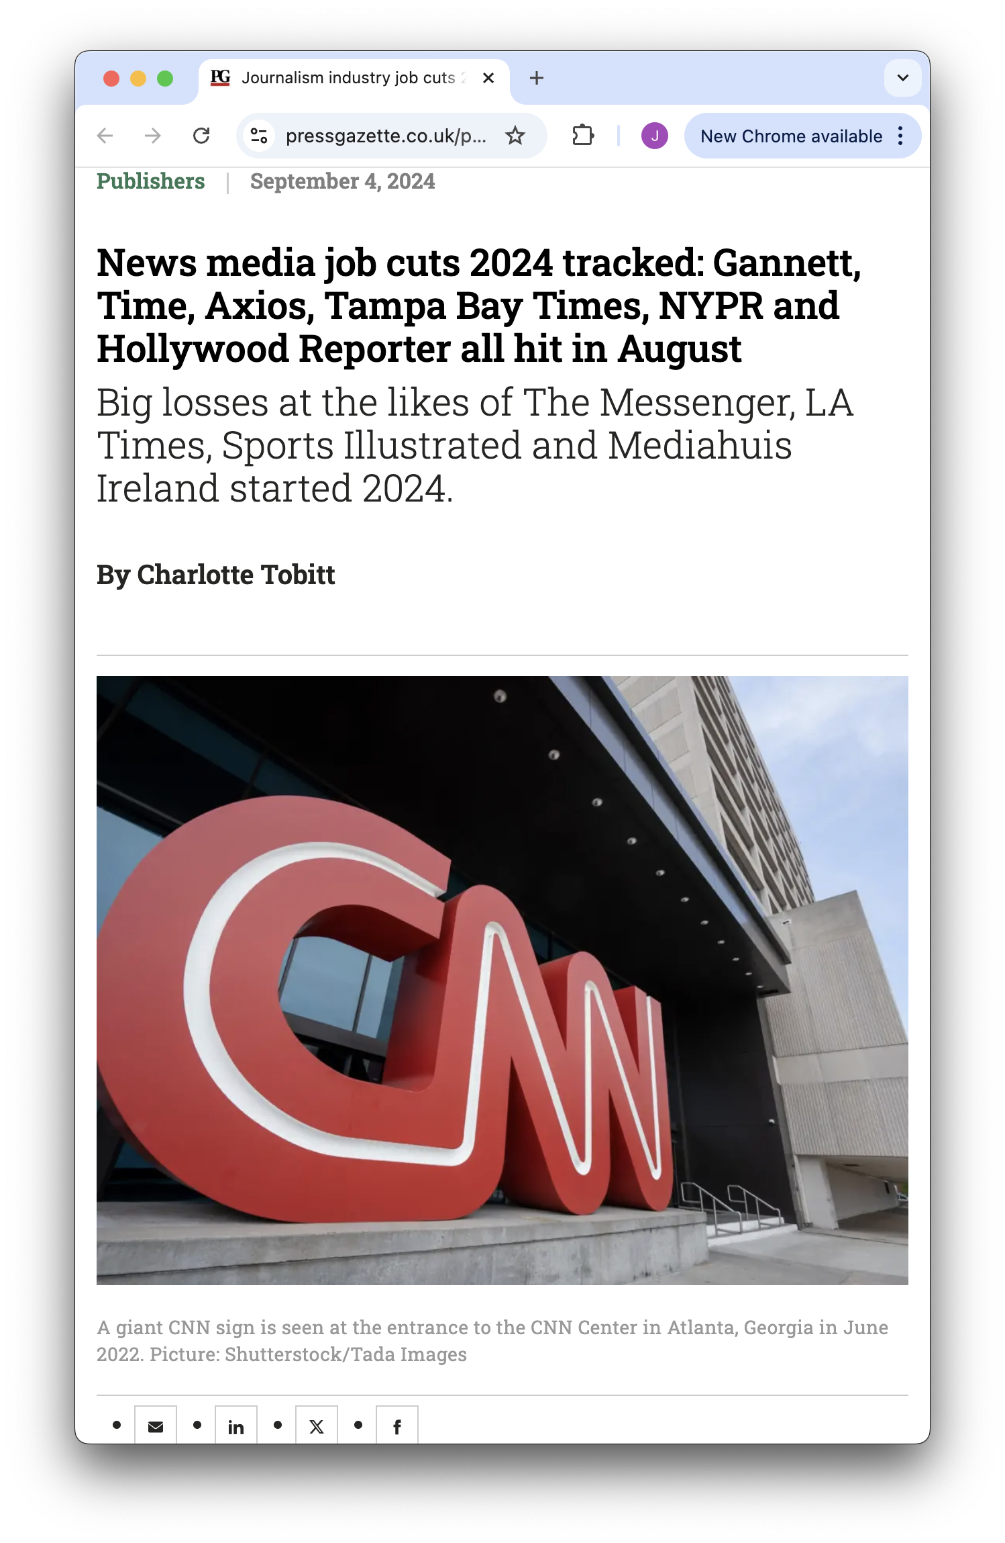
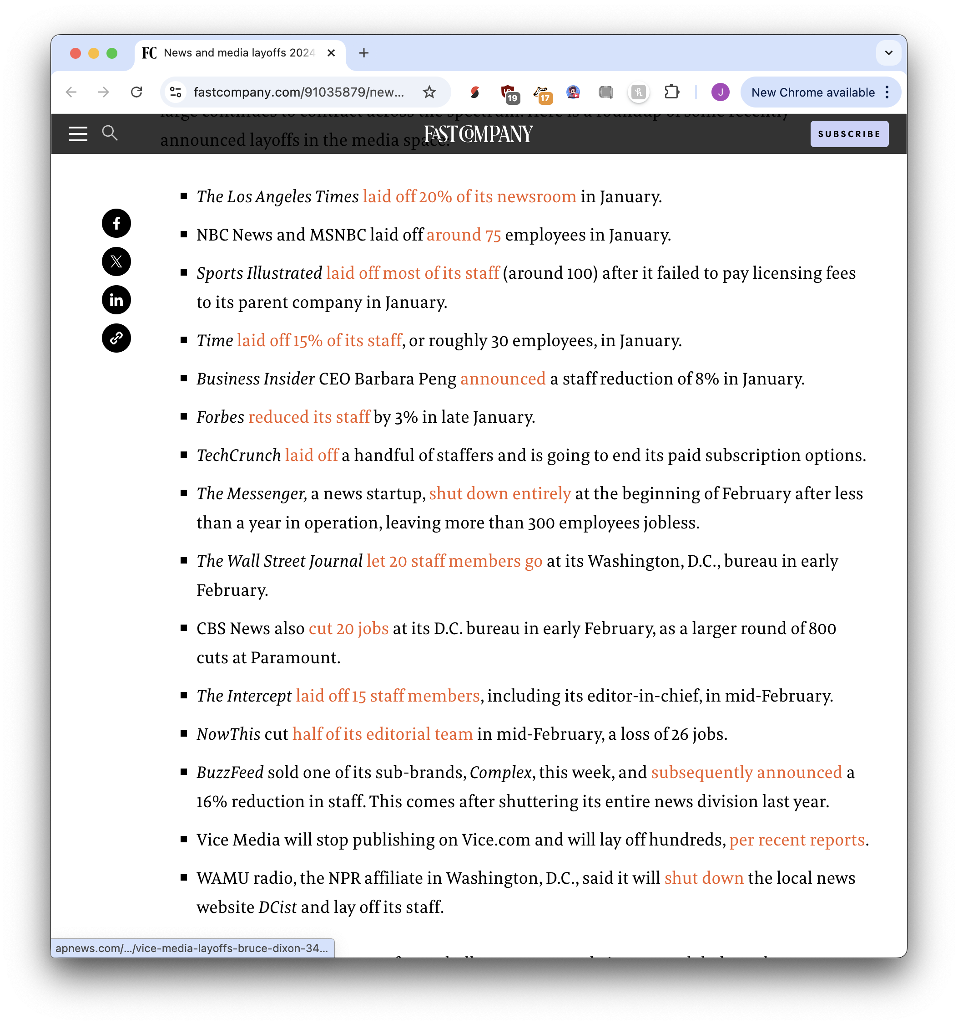

journalism layoffs…

Slide 5
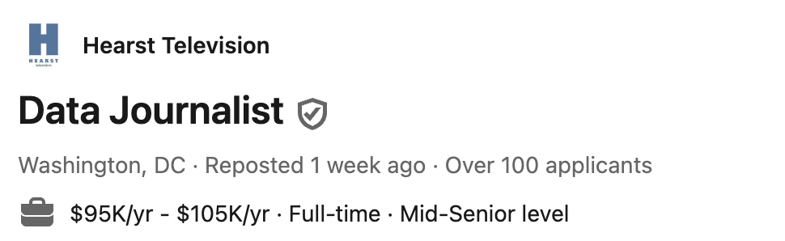


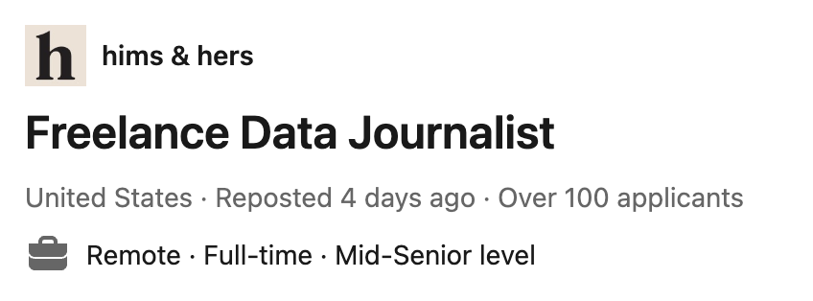
…but data is booming!

Slide 6
data is flexibility
taking information, explaining it to others

Slide 7
new business plans
Non-journalism companies need to communicate
A journalism organization in Brazil scrapes legislation, organizes and categorizes it, then sells the information to lawyers
Skilled interactive news and graphics teams do development work for large, well-paying clients to support their journalism work
With a little extra knowledge and skills, many many many many many more things are possible

Slide 8
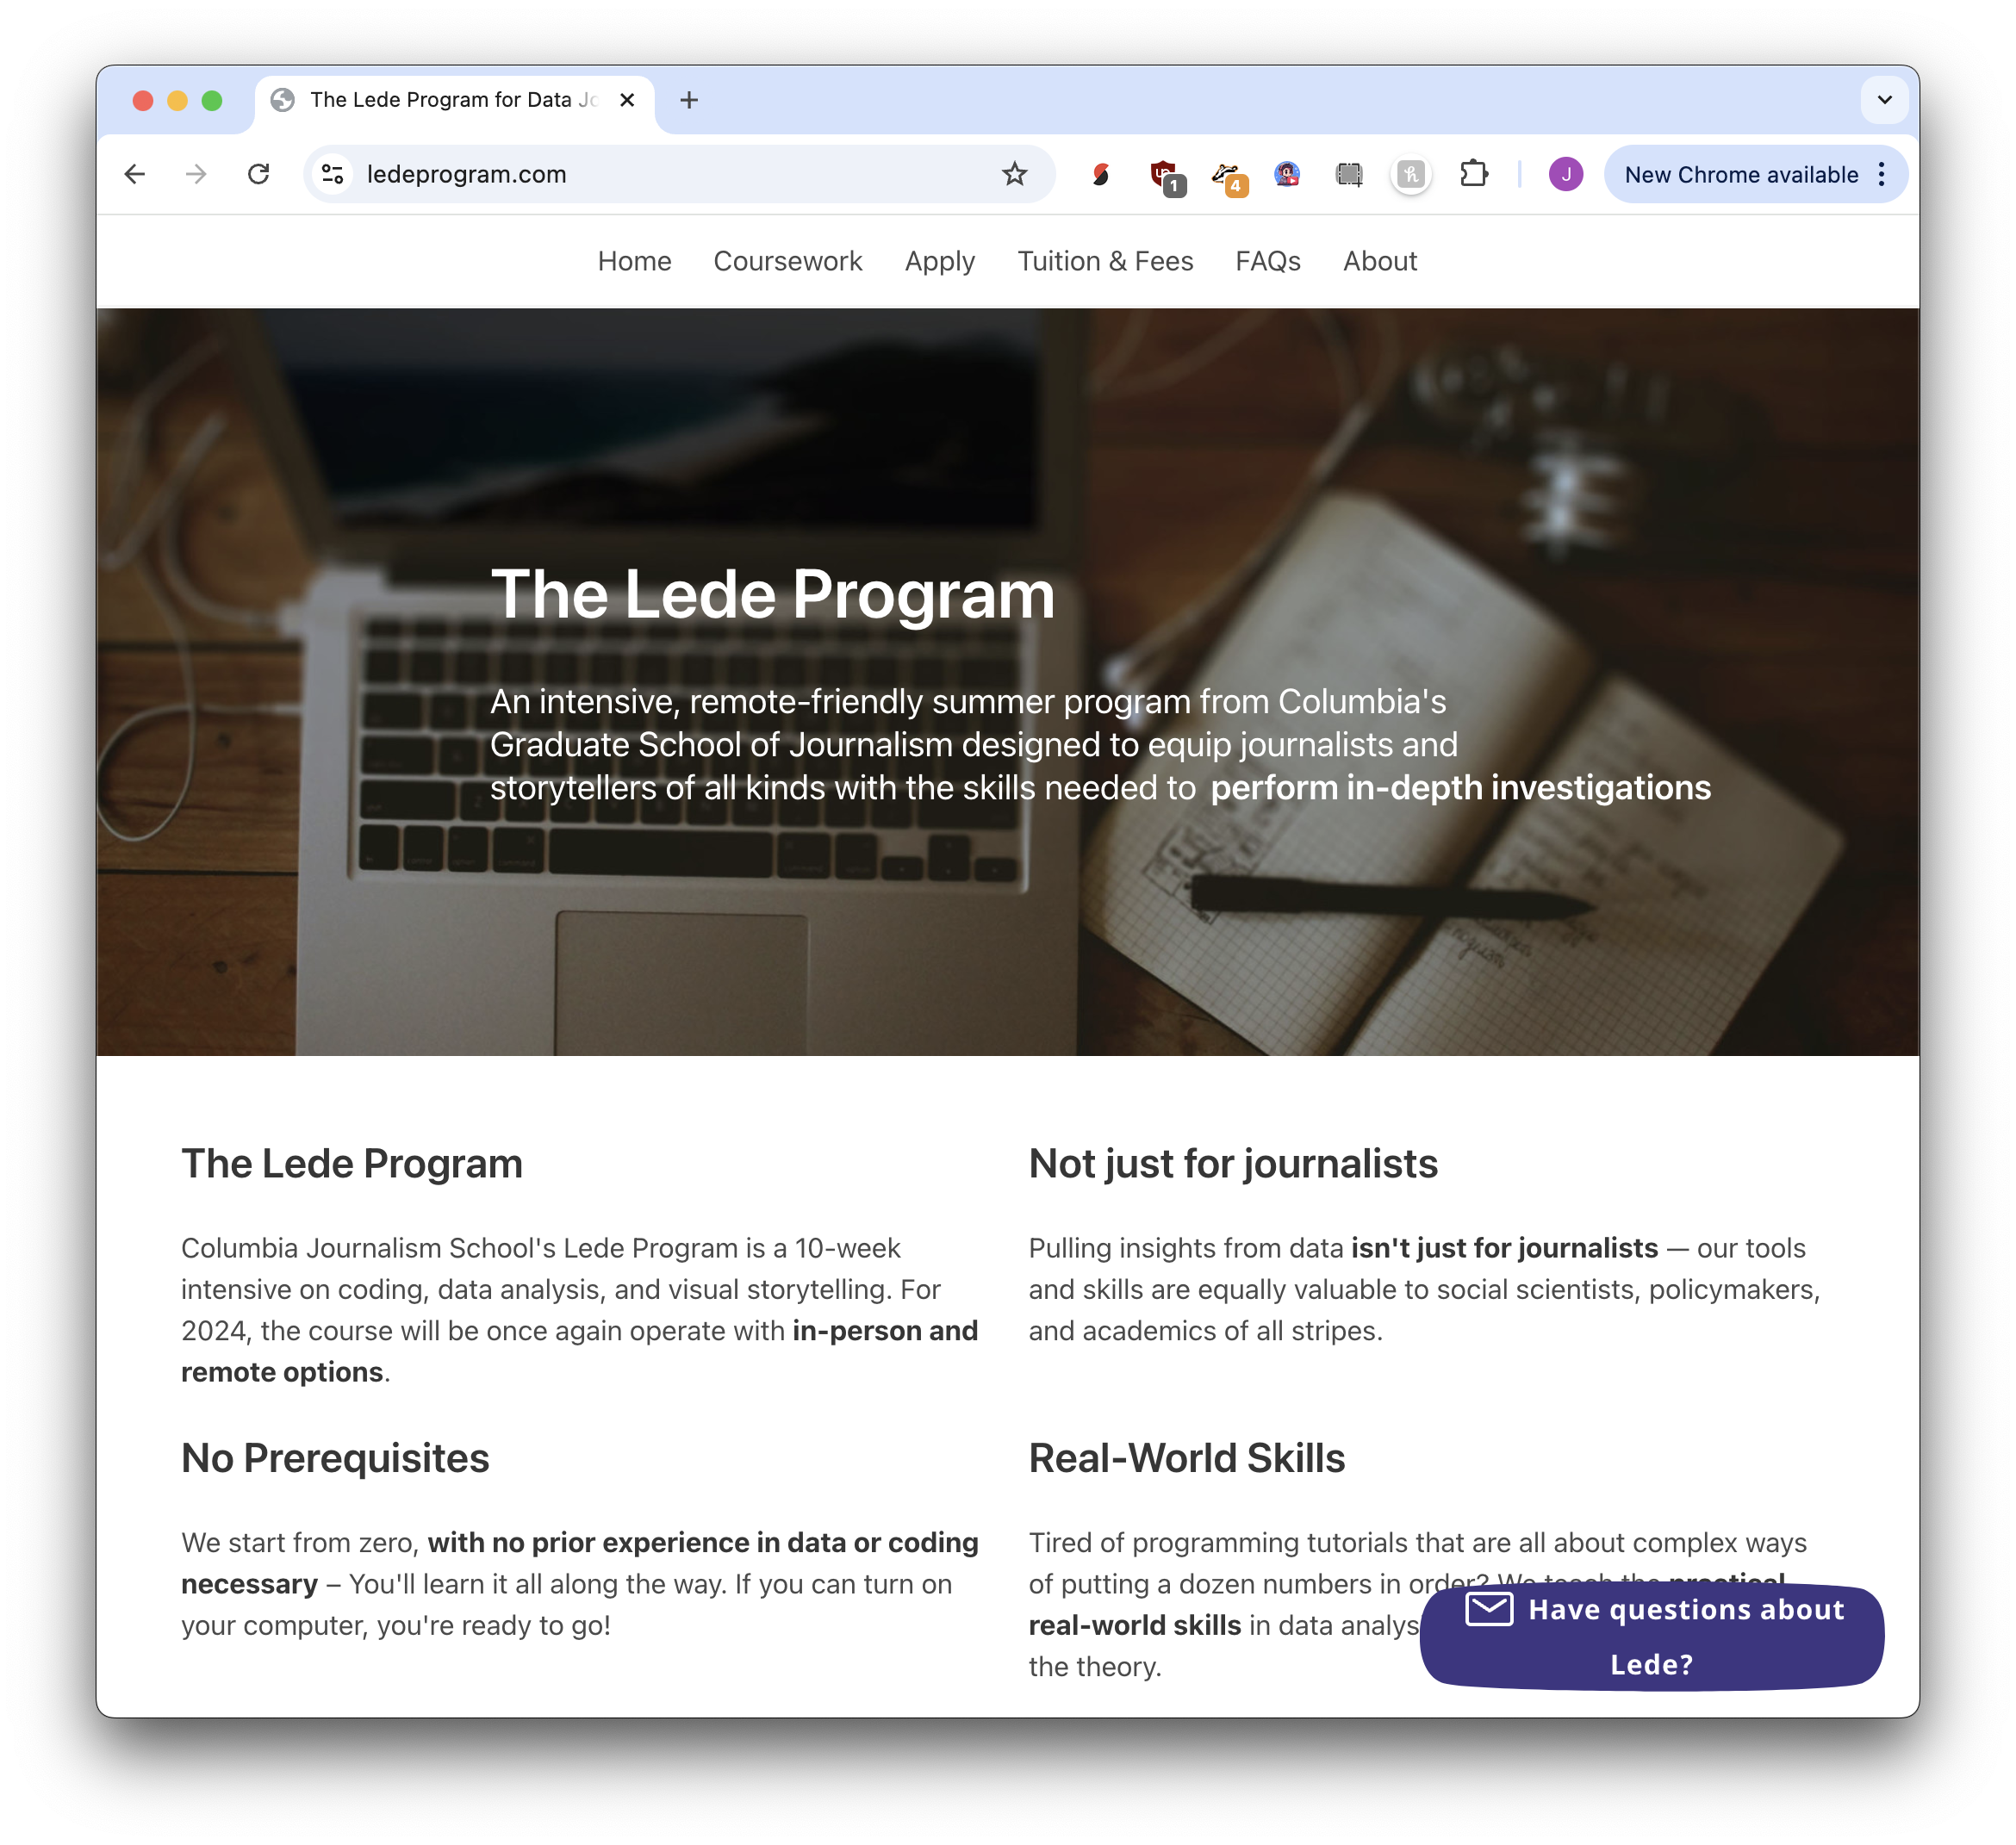
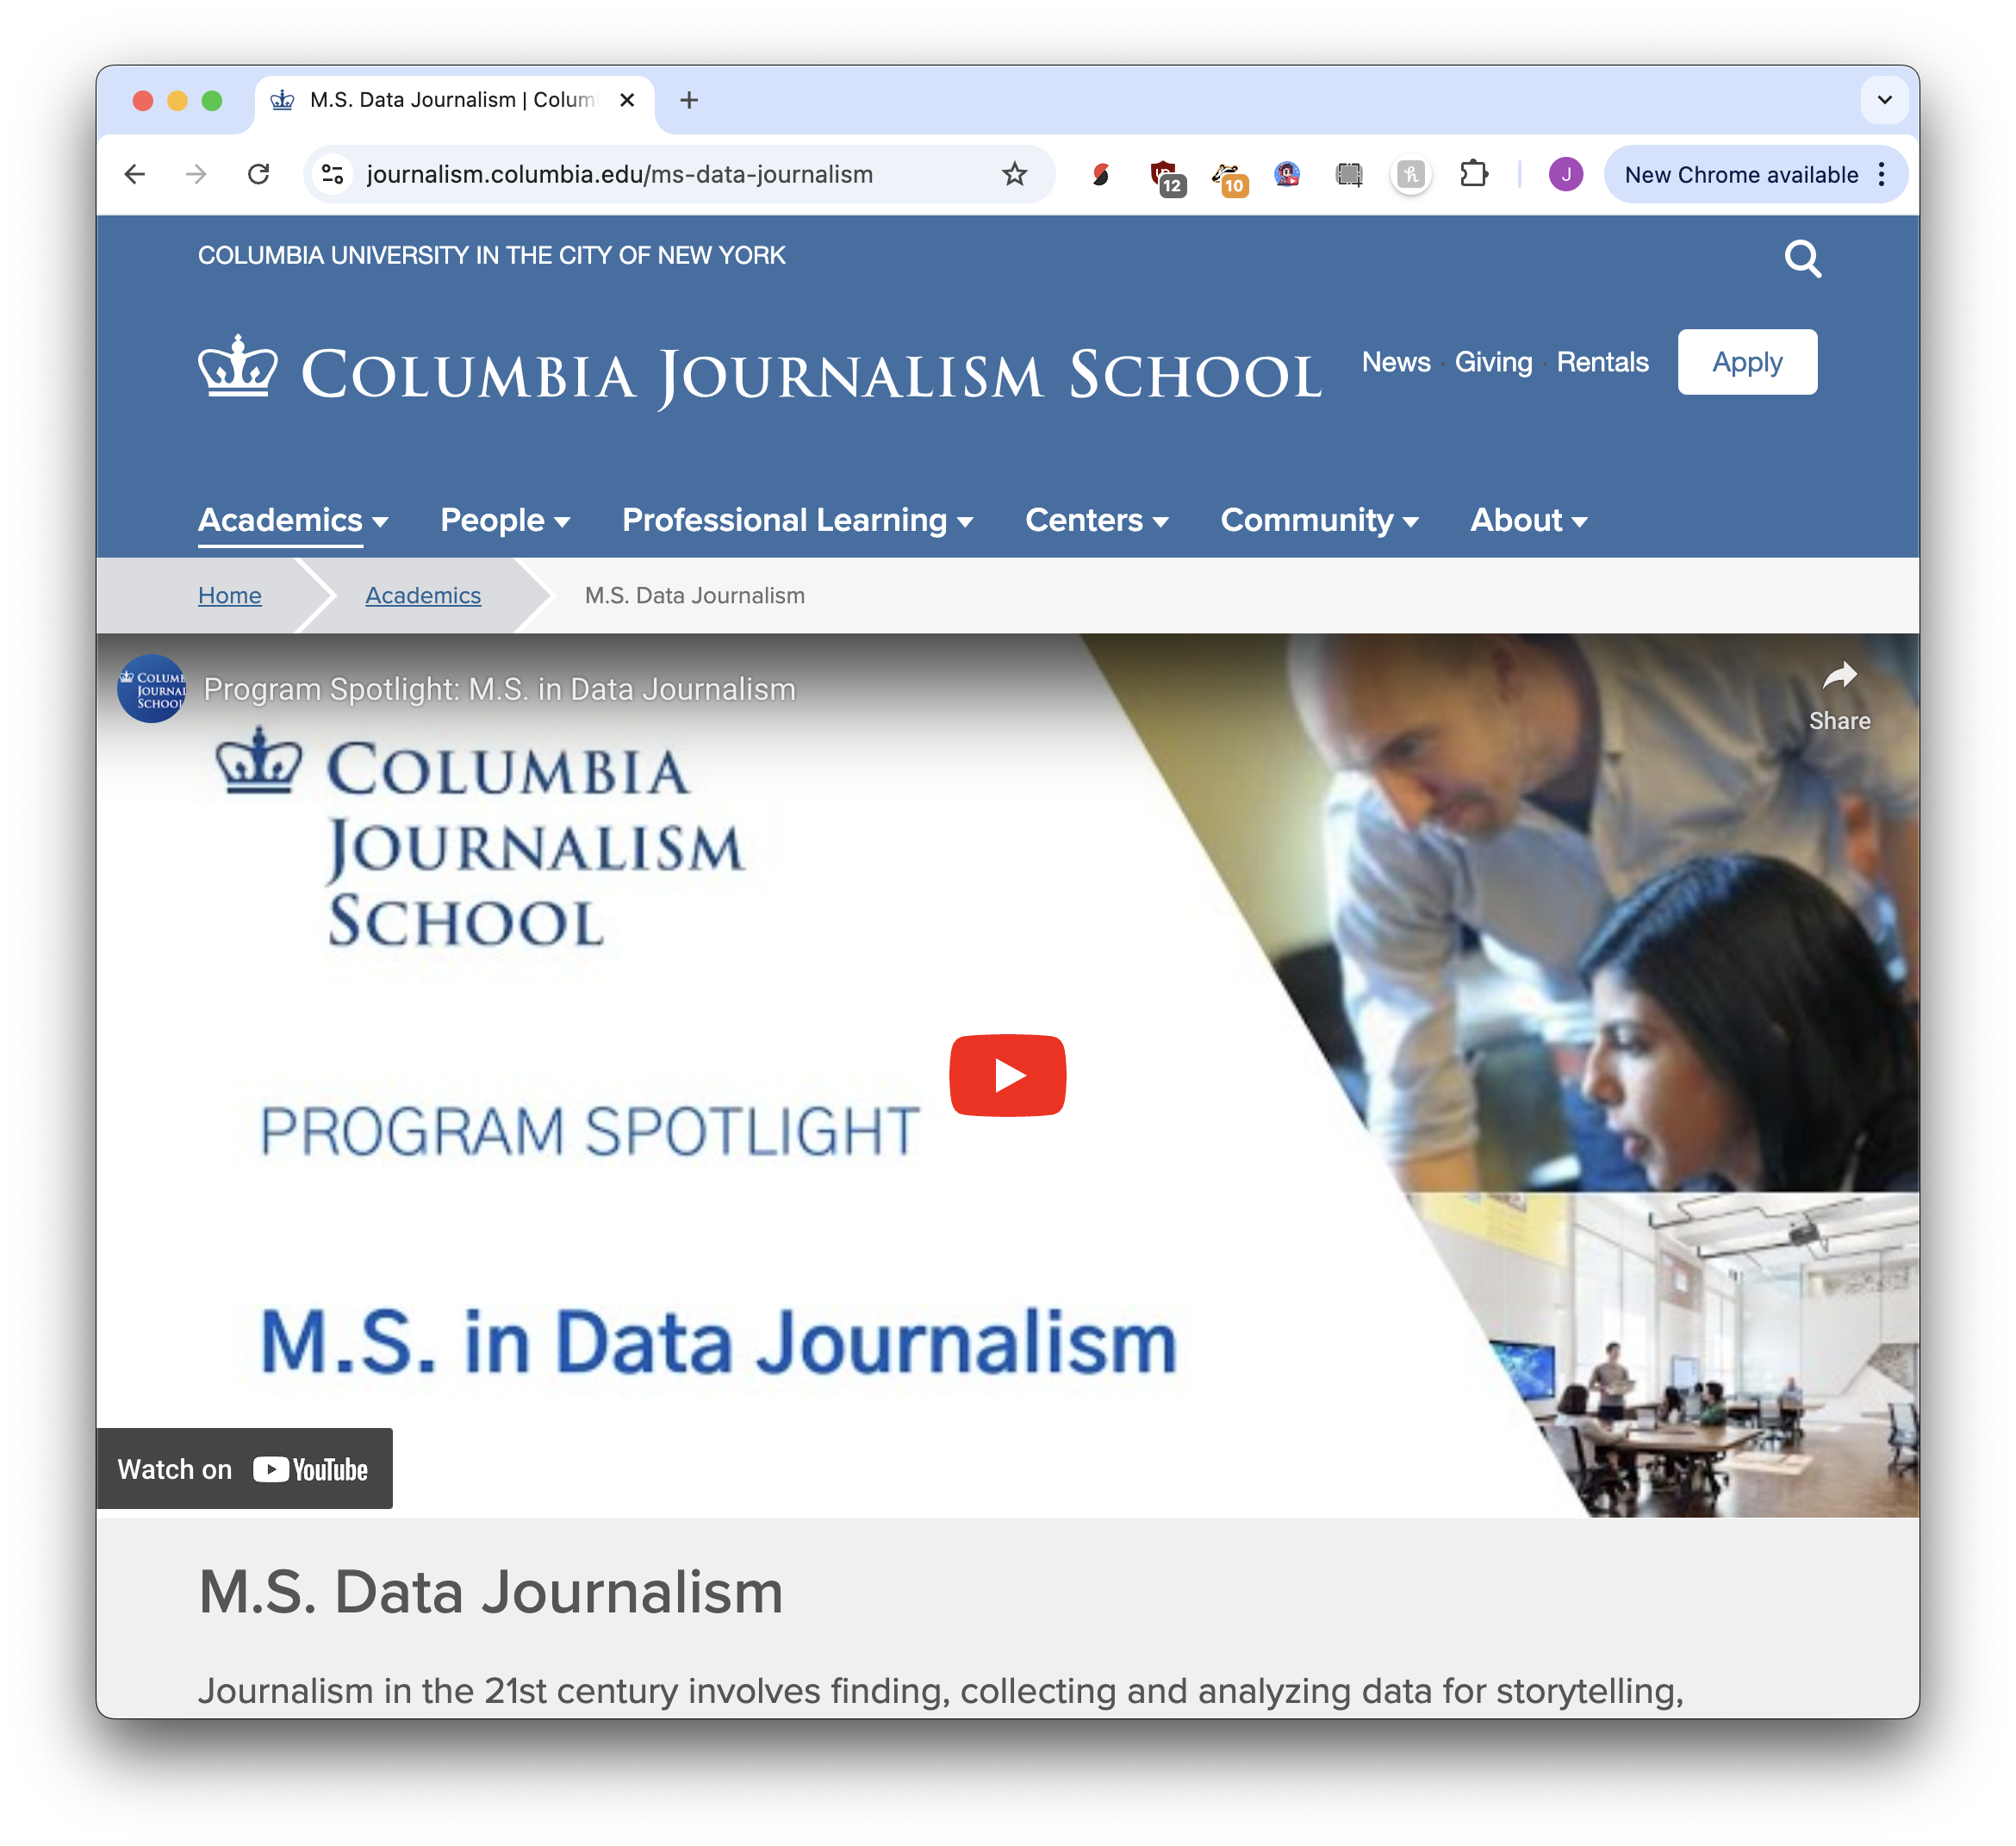
10 weeks
12 months

Slide 9

one week!

Slide 10
Goals
We are not aiming for expertise!
We are aiming for foundational knowledge
We want to be adaptable

Slide 11

“with time, I can accomplish this”
…almost? maybe?
What you don’t know, you can learn.
With a good foundation, everything is possible.

Slide 12
introductions
Turn to the people next to you, in front of you, behind you. Introduce yourself. Where are you from + why are you here?

Slide 13
ask questions!!
important!!!!!
asking questions is how you learn, and I am sure everyone wants to know the same thing

Slide 14

Our schedule
Monday through Friday + Monday
Class during day
Homework
Optional!
A large amount for learning later
This Friday: Working on personal projects
Next Monday: Project presentations

Slide 15
What we’ll learn
Coding: Fundamentals of Python
Data analysis: pandas (Excel for Python)
Structured data: APIs
Unstructured data: Scraping
AI tricks: Transcription, data tools, app building
Data visualization: Coding and no-code tools
Project planning: Make sure you finish!

Slide 16

Python programming
Fundamental to every other skill
A superpower that allows you to do anything
Not just “coding”: Python is special
Academic for research
Industry for software development
Online tools, desktop applications, databases
Powers most of the AI tools

Slide 17
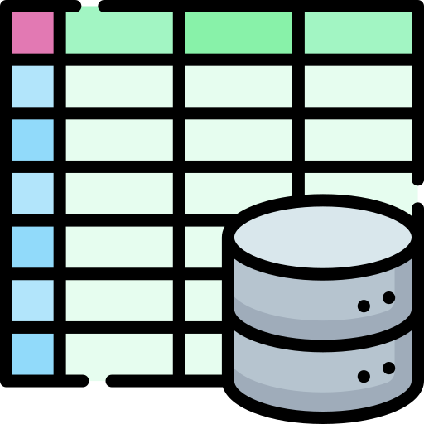
Data analysis
A person produces ~6GB of data per hour
Excel has limitations, so we turn to Python
Data makes arguments more convincing
…but that makes me sad
Just one more source of information

Slide 18
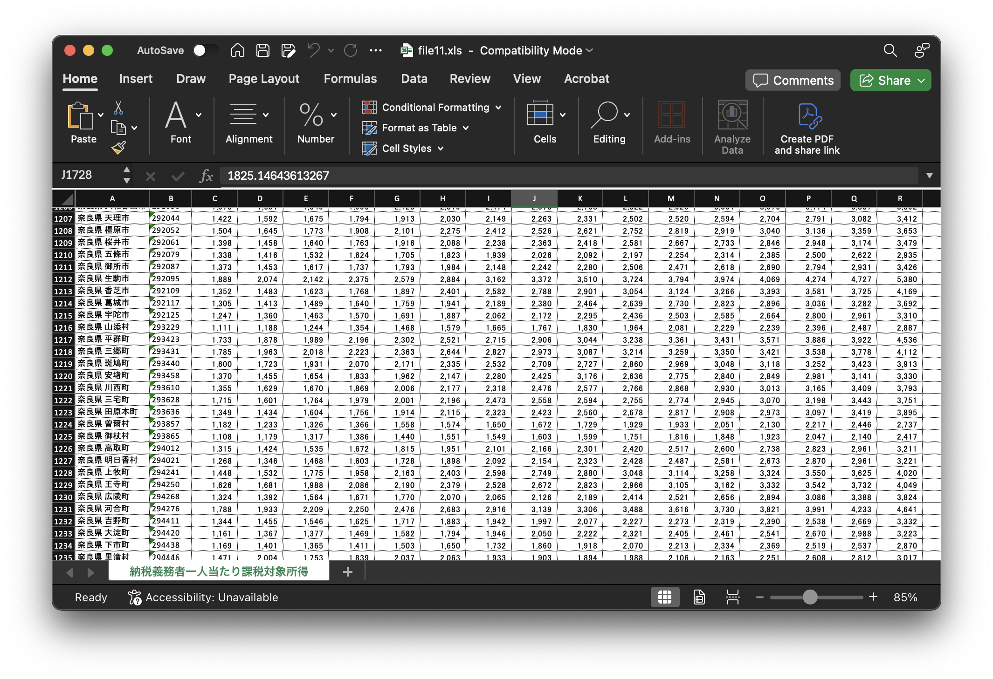
Structured data
Data that is easy for computers to understand: Excel, CSV, XML, JSON, APIs, databases
APIs: Computers talking to computers
Available from governments and industry
Easy to reformat or process to display to members of your company or customers
Add value by combining with other data

Slide 19
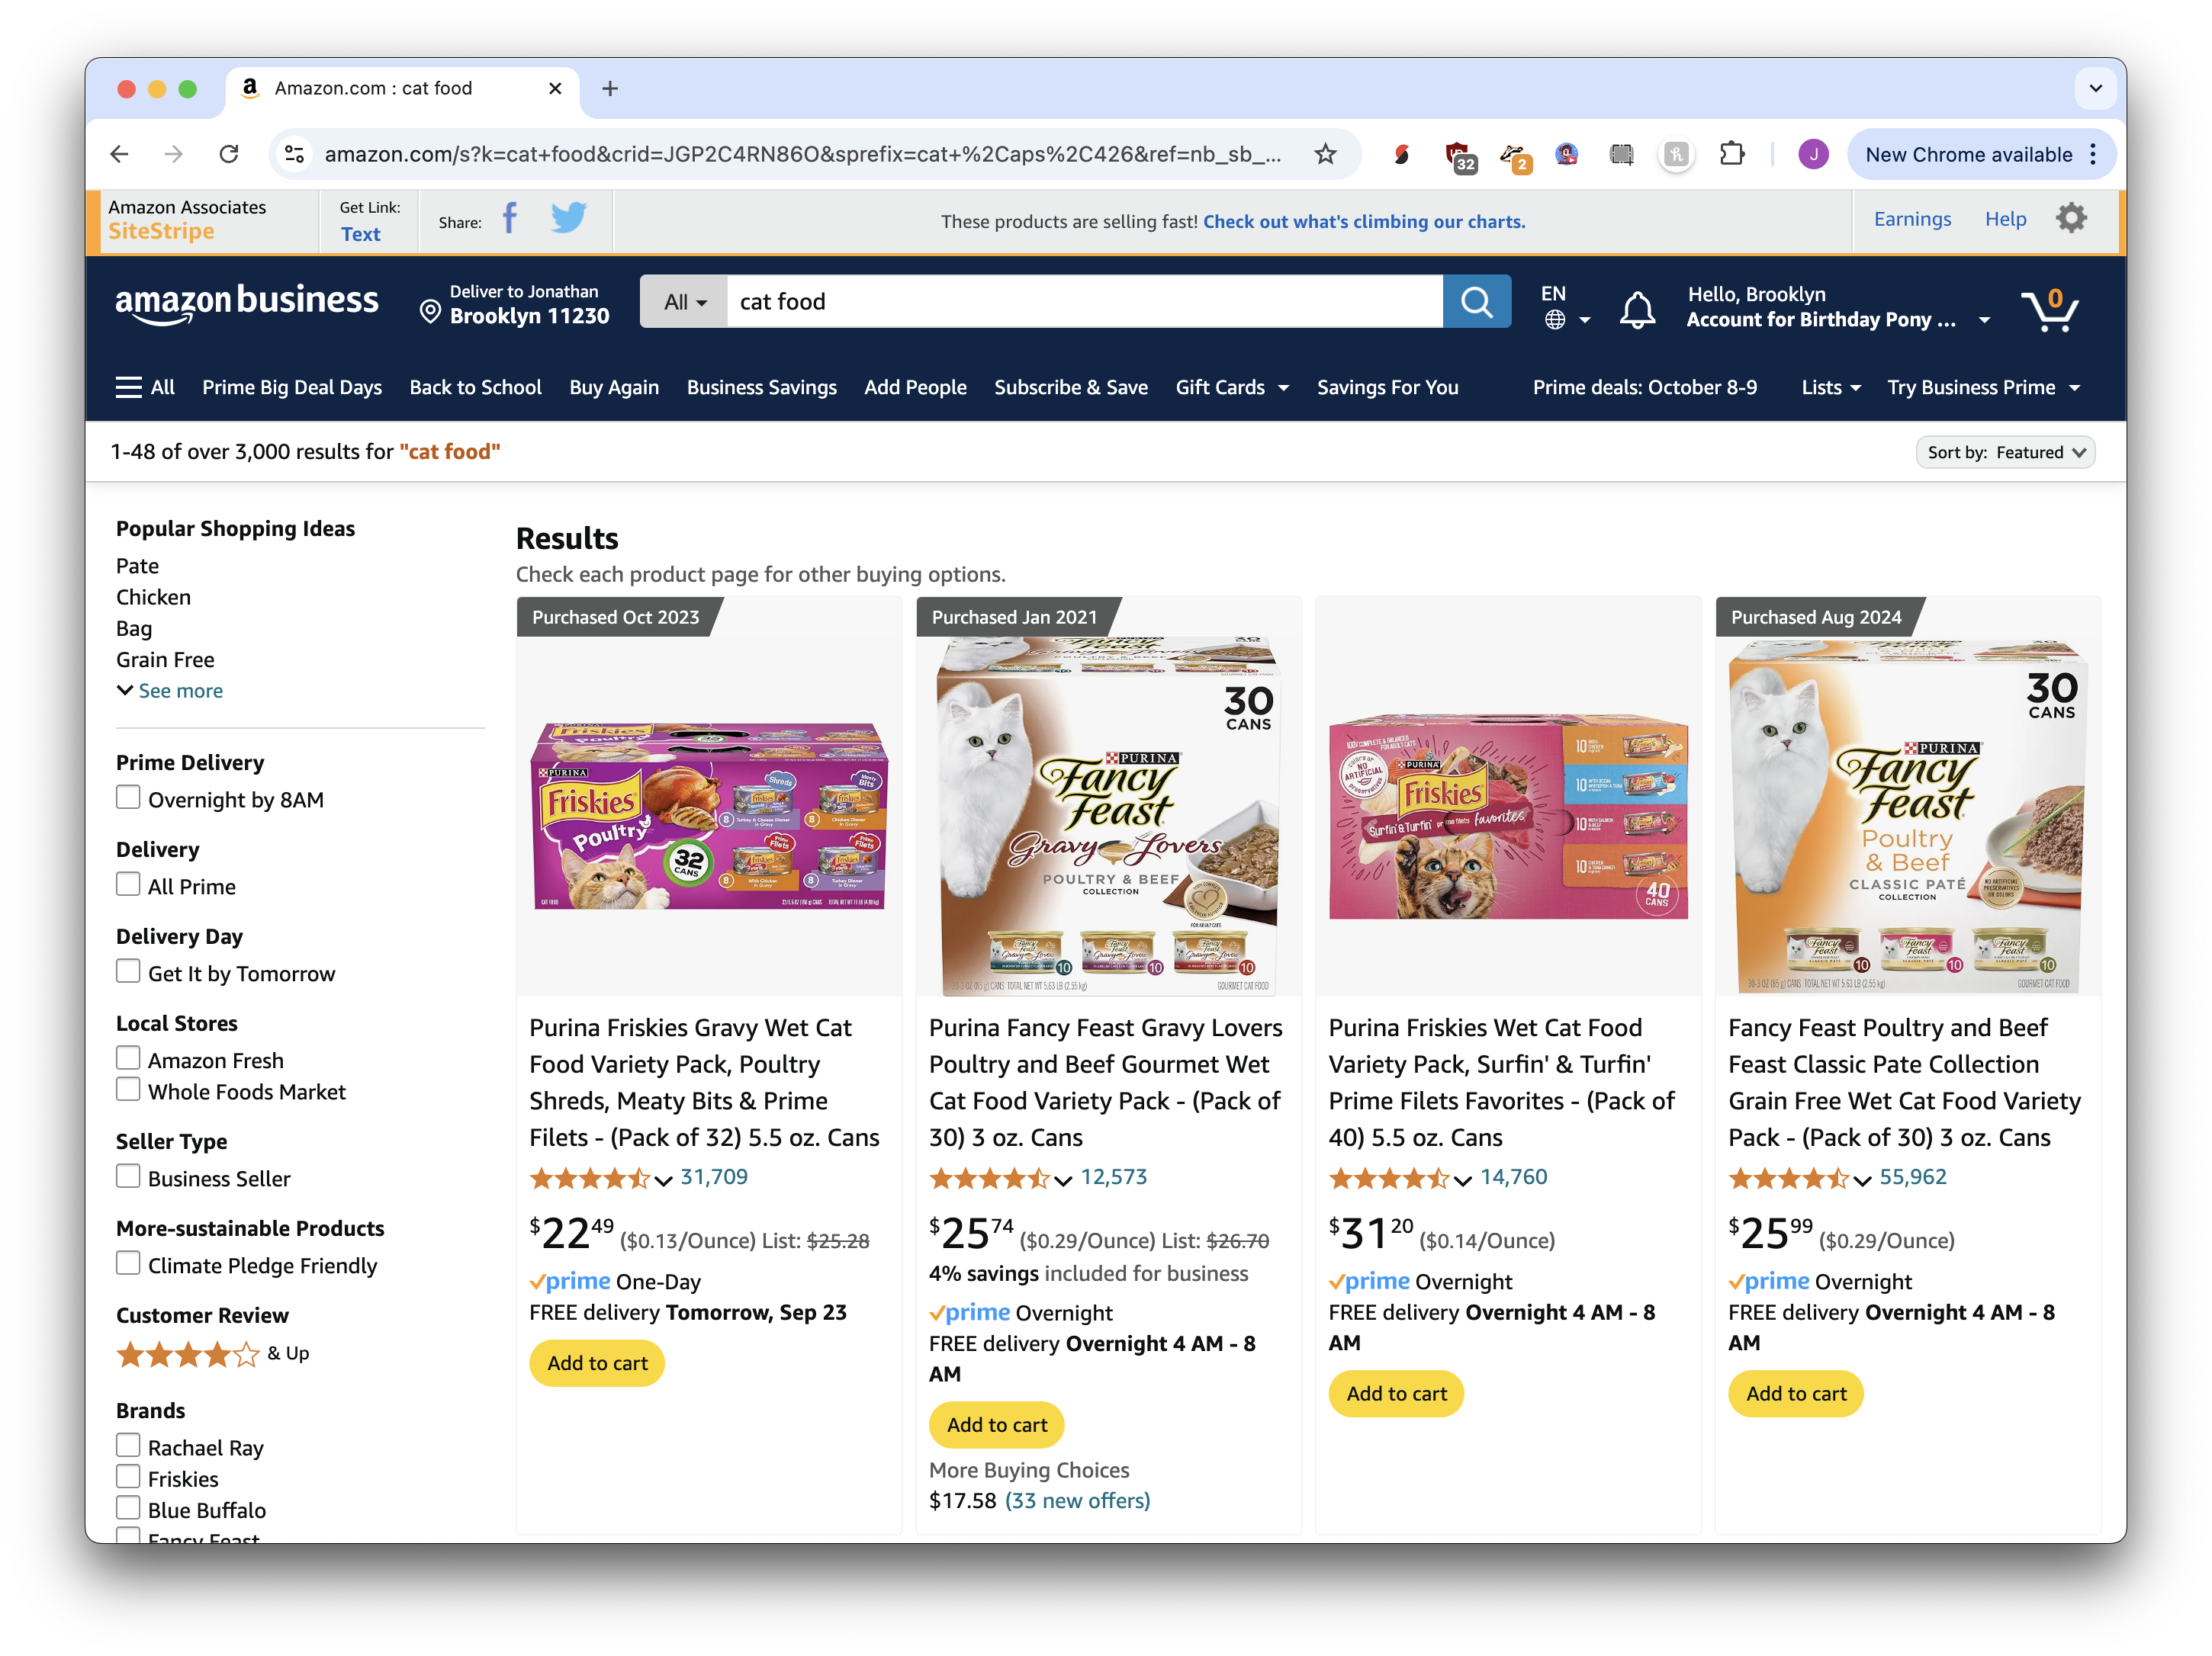
Unstructured data
Data that is easy for people to understand
Our job is to make computers understand it
Scraping data from websites
Extracting data from text or PDFs
Add value by processing it!

Slide 20
AI tricks
Accomplish impossible tasks!
Be successful with skills you don’t have
Get better with skills you do have
Automate “grunt work” and “intern jobs”
It’s for more than rewriting emails :)

Slide 21
Data visualization
Communicating with data is difficult
Sell your content more effectively
Everyone loves charts and graphs!
Project Planning
Estimating time is very difficult for tech projects
Finishing is the hardest part

Slide 22
Hello world: AI!
we have a secret weapon, it’s artificial intelligence

Slide 23

A.I. is not
perfect

Slide 24
A.I. should be used for
error-resilient tasks

Slide 25
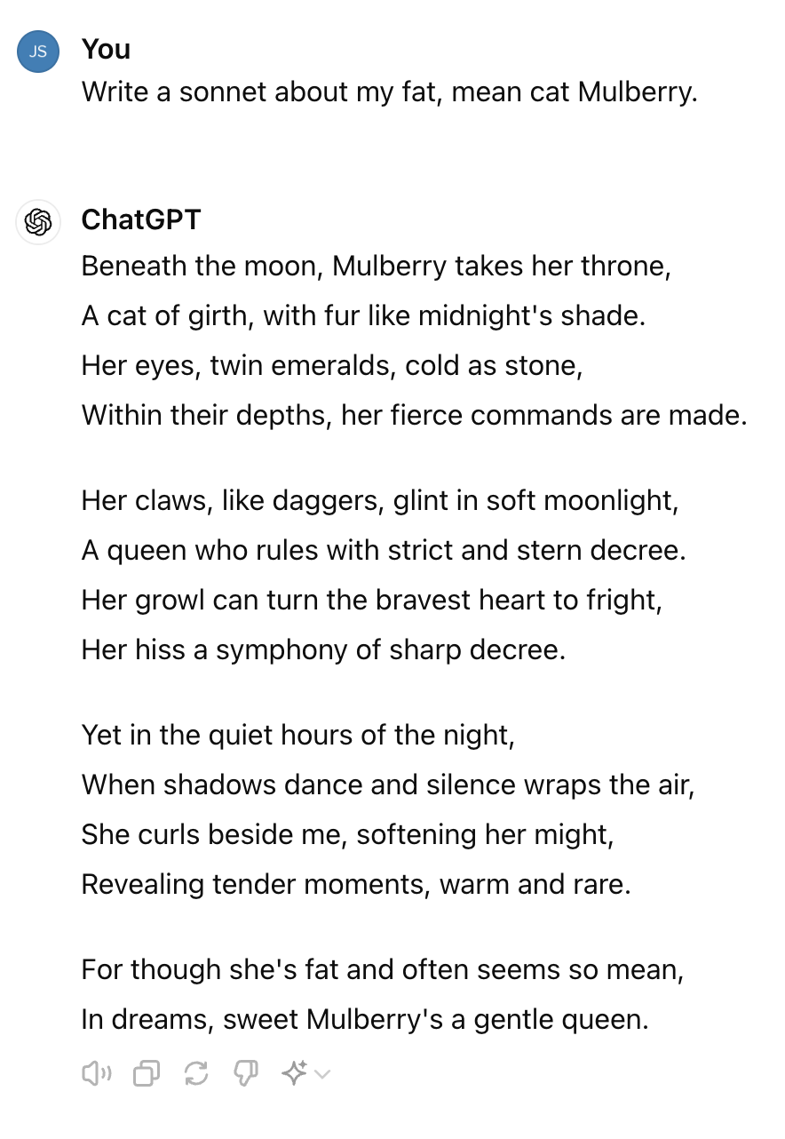
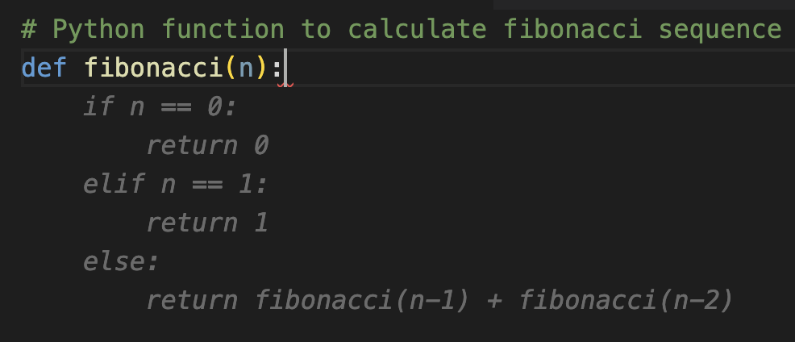
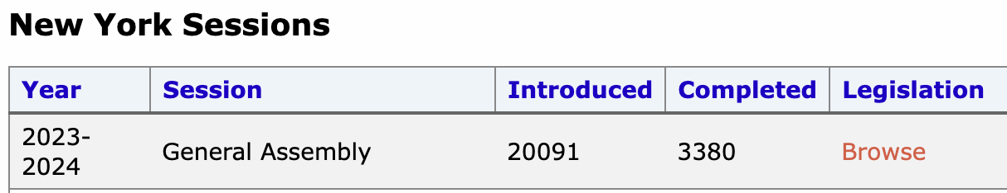
tight feedback loops
low-quality output is ignorable
errors are expected
(a.k.a. “intern work”)

Slide 26
tight feedback loops

Slide 27


Centaurs and cyborgs
Clear division of labor between AI and person
One task for AI, one task for human
Intuition of humans, trust in AI
Intertwined, deep integration of AI into human work
Collaborative, back-and-forth process
we will be both!

Slide 28
any questions?
that will be our week!

Slide 29

Time for a survey!
https://bit.ly/ds-dojo-survey

Slide 30
Software Installation
Usually the worst part. This time, not terrible!

Slide 31
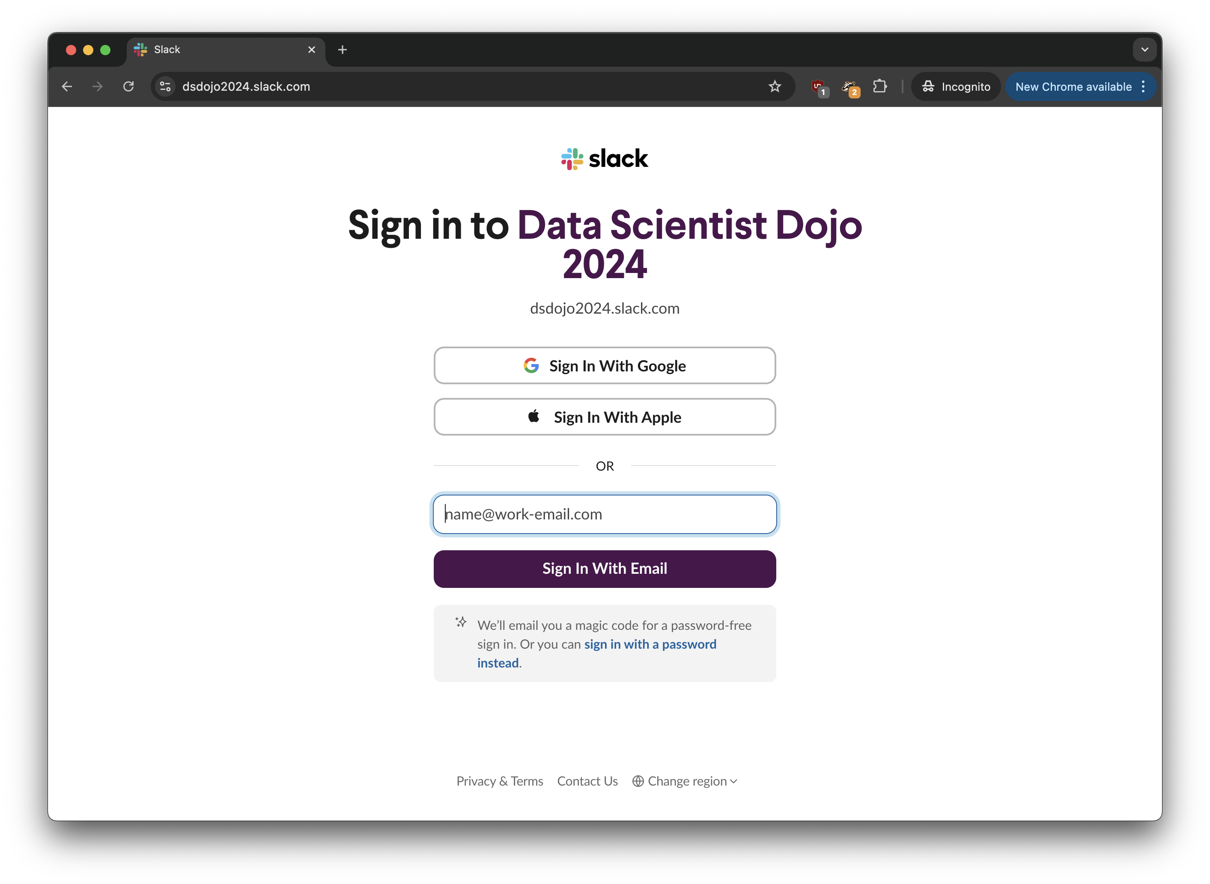


dsdojo2024.slack.com
Join Slack
Slack: for communications and cut-and-paste code
We will invite with the email you signed up with, tell us if you want to use a different email

Slide 32
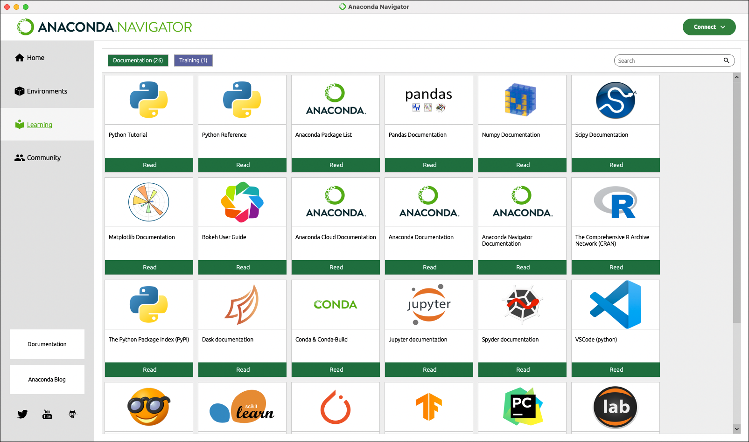
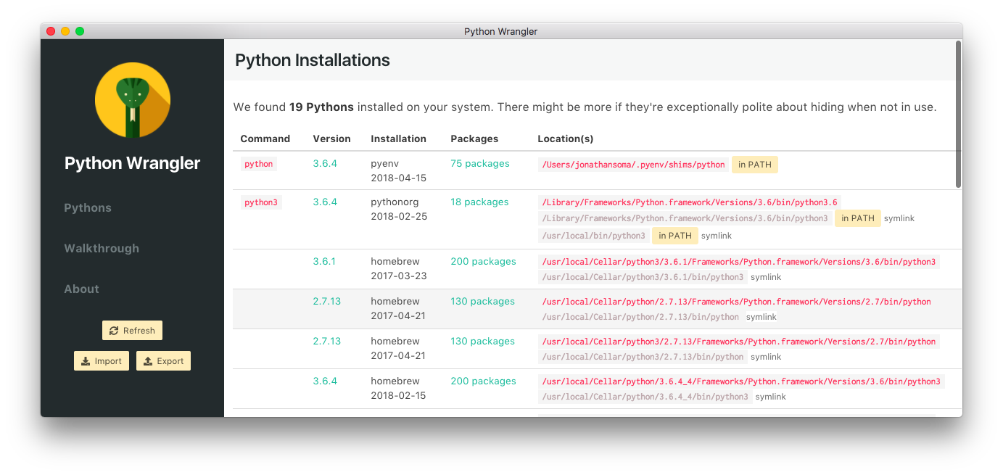
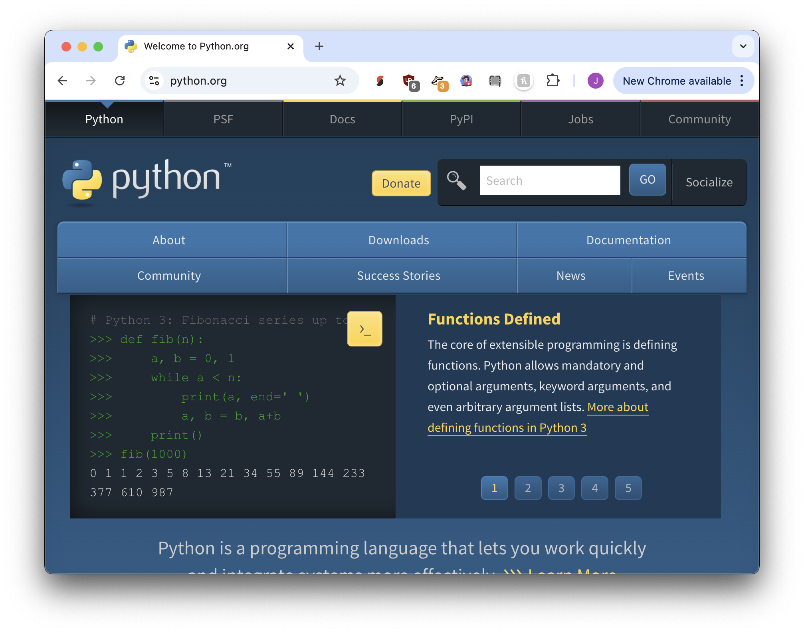
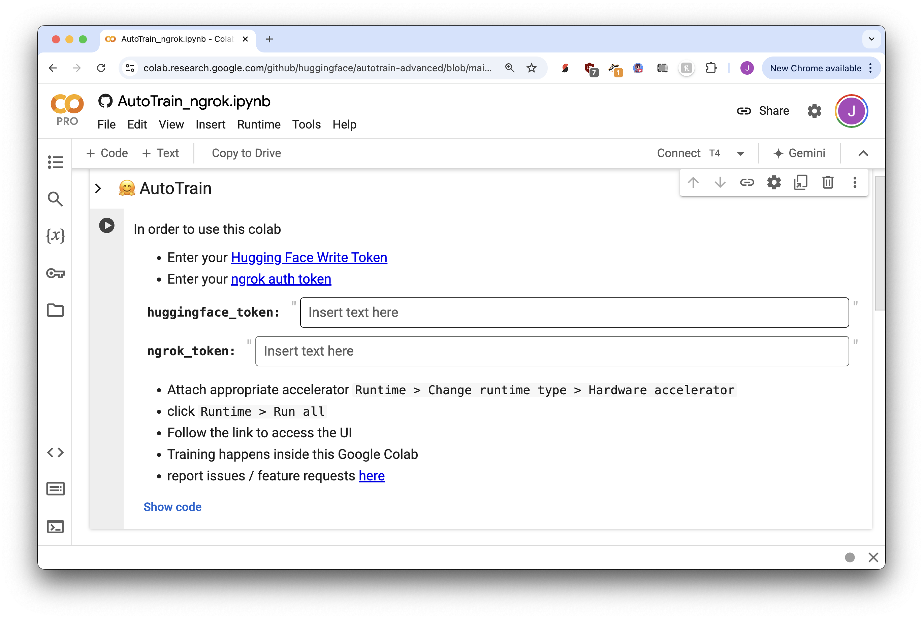
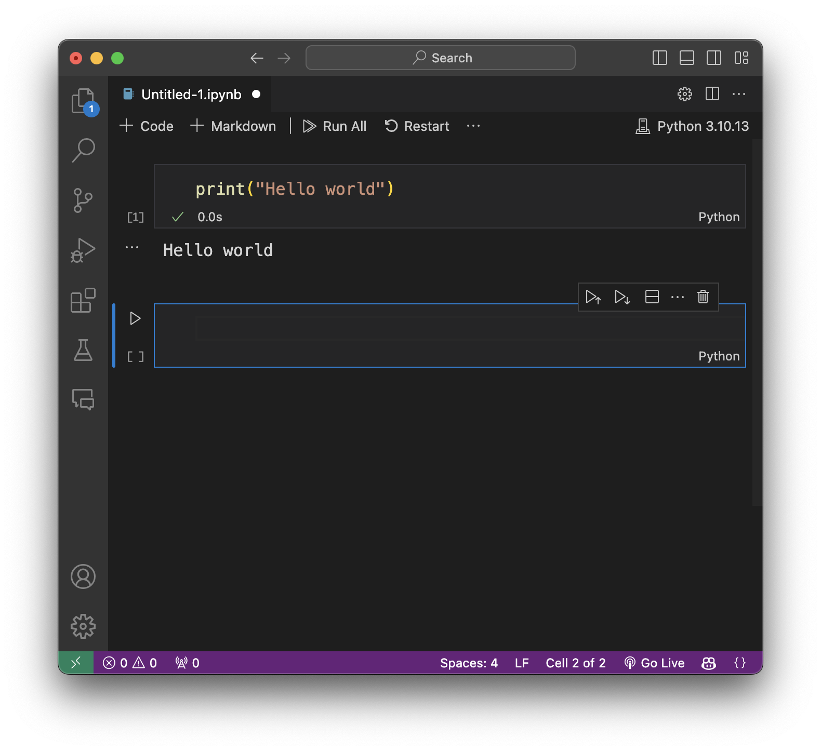
Running+Installing Python

Slide 33
Running+Installing Python
Anaconda: Popular with data scientists
Simple installation
Visual Studio Code: Popular for web site development
Integration with many common tools
Google Colab: In the cloud, popular for AI development
Easy access to powerful computer resources
Jupyter: Popular with data sciences and data journos
Good for having “conversations” with your data
It doesn’t matter which you use!!!!!! They are all a little difficult to set up and use.

Slide 34
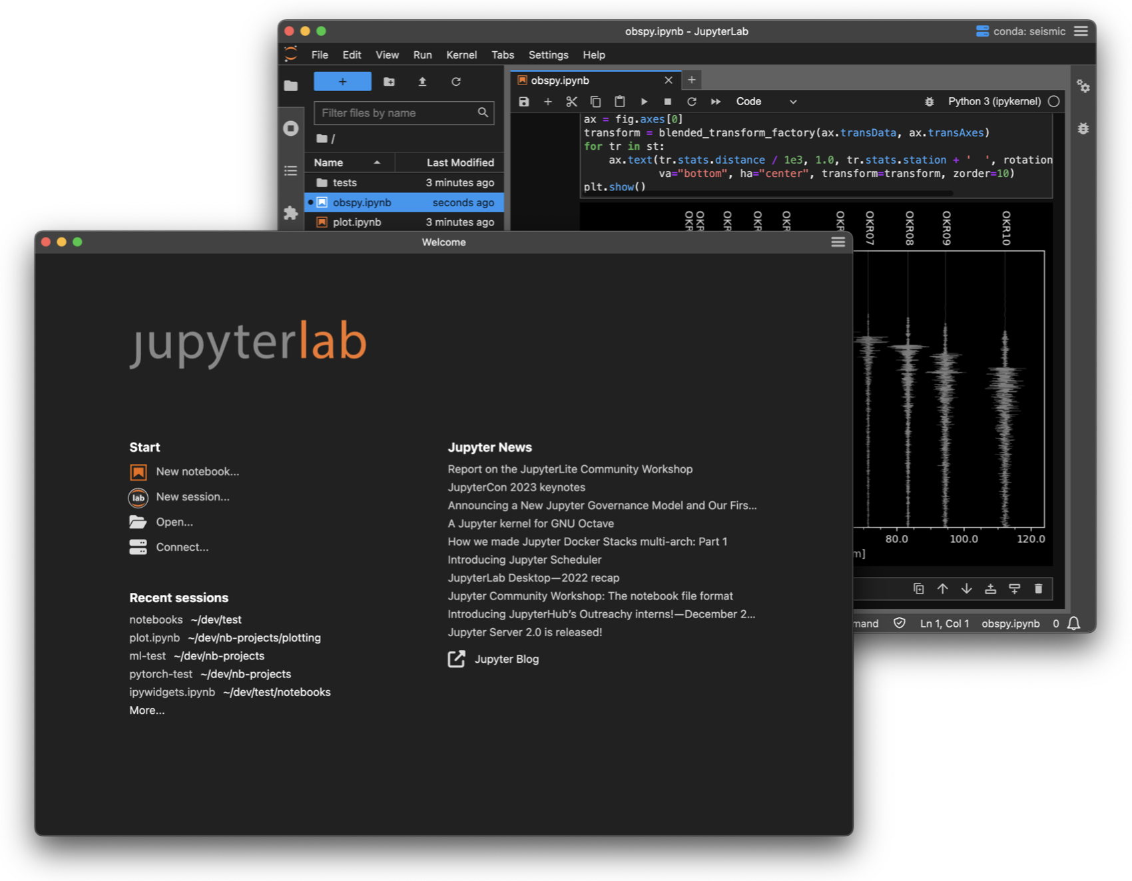
JupyterLab Desktop
https://bit.ly/ds-jupyterlab
Windows, Macs, Linux
Very easy to install
No trouble with Python
Easy to change to more “professional” tools later

Slide 35
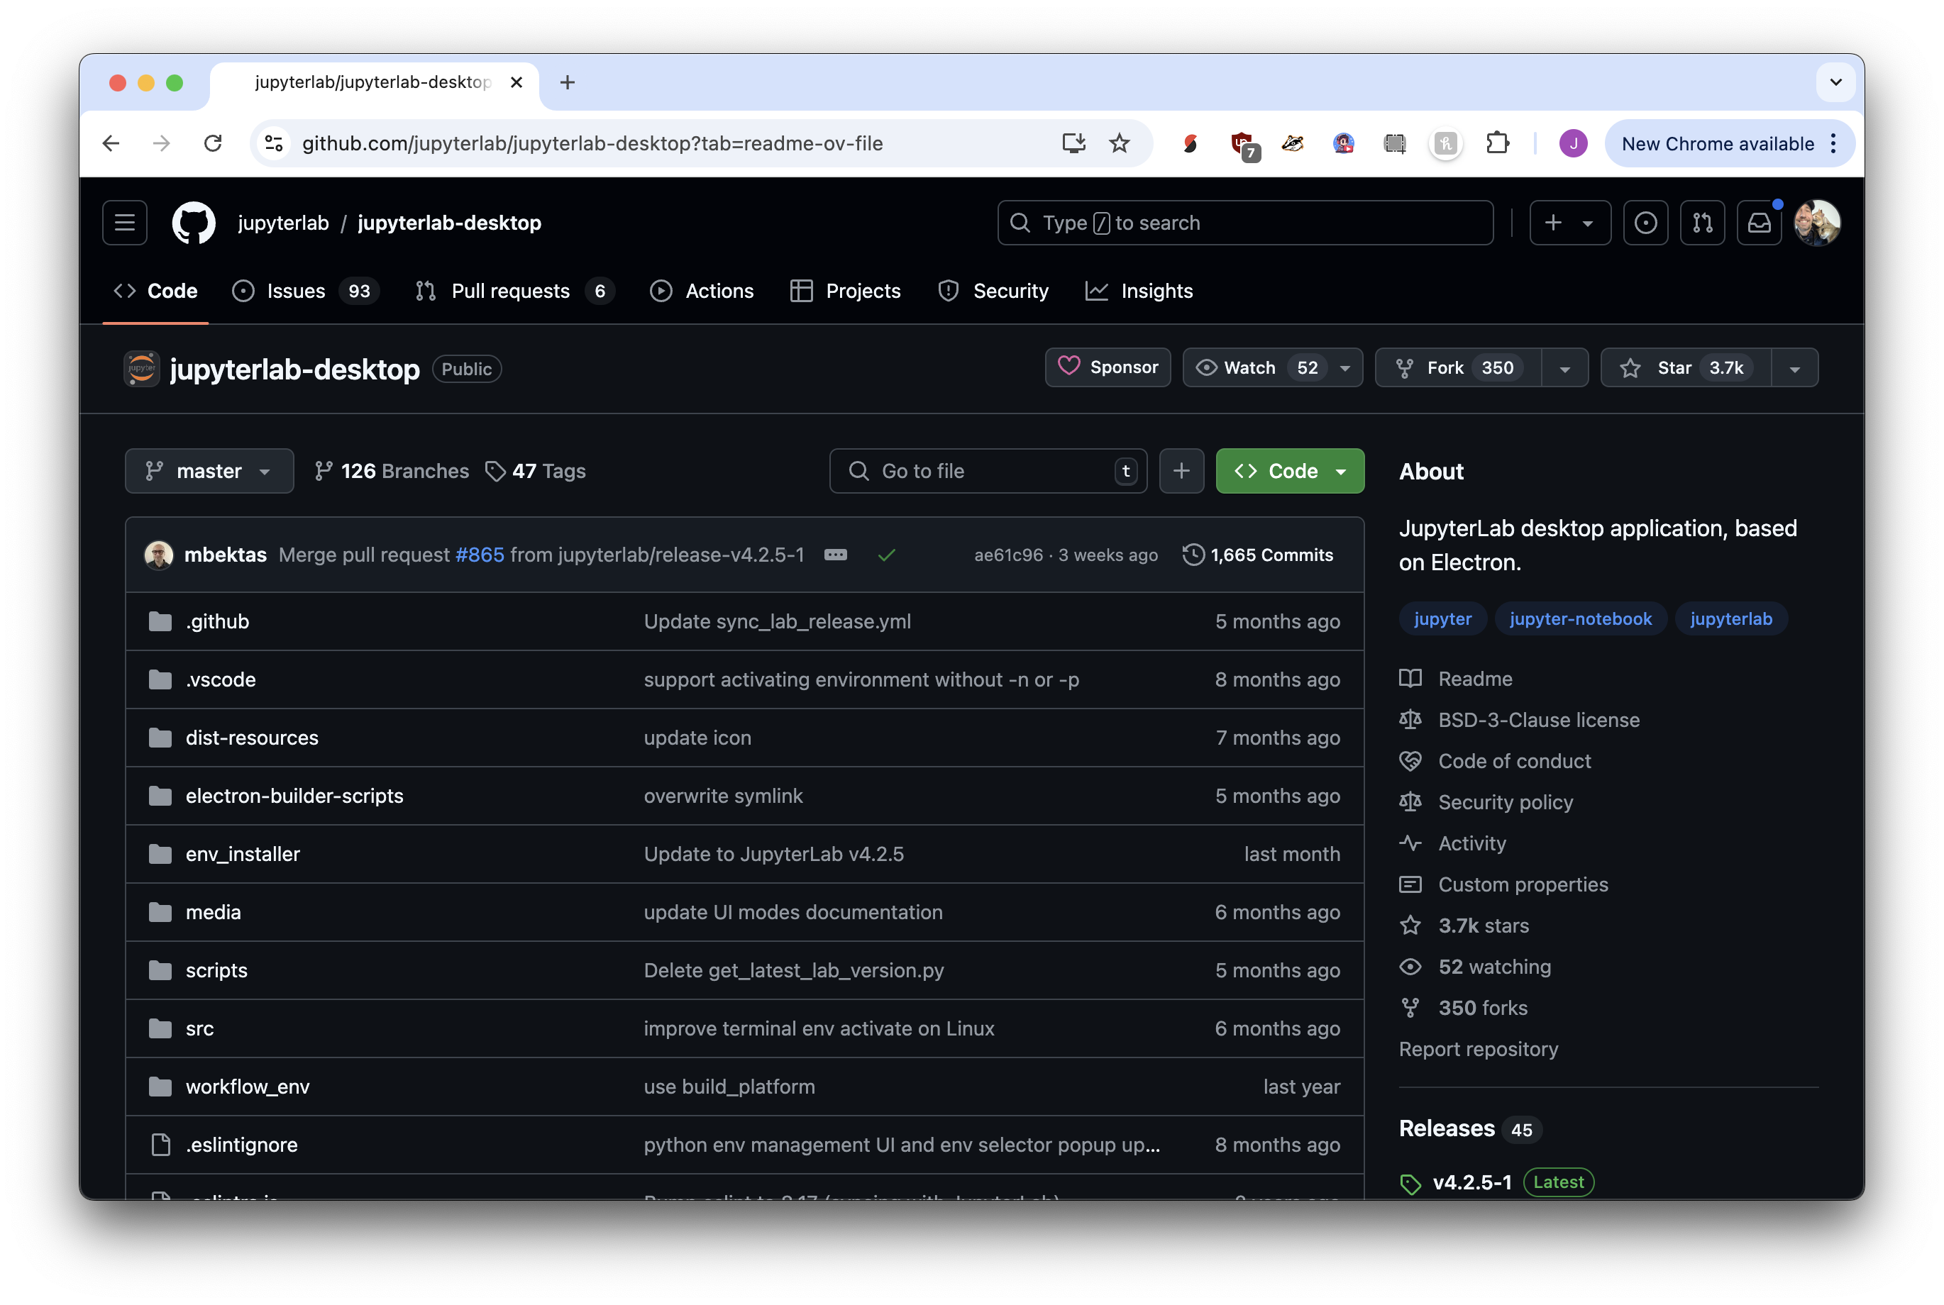
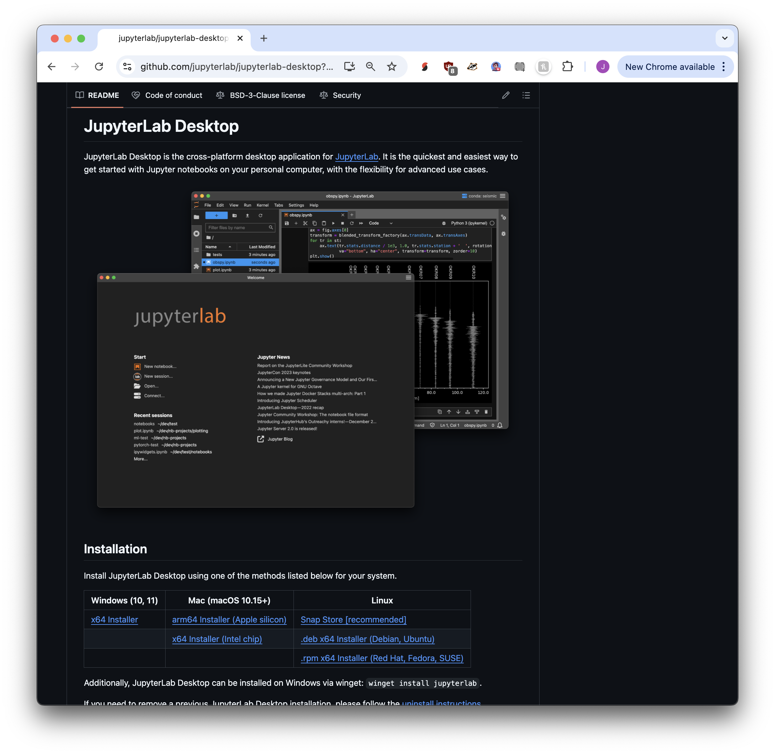


① Visit https://bit.ly/ds-jupyterlab
② Scroll down
③ We want “Installation”

Slide 36
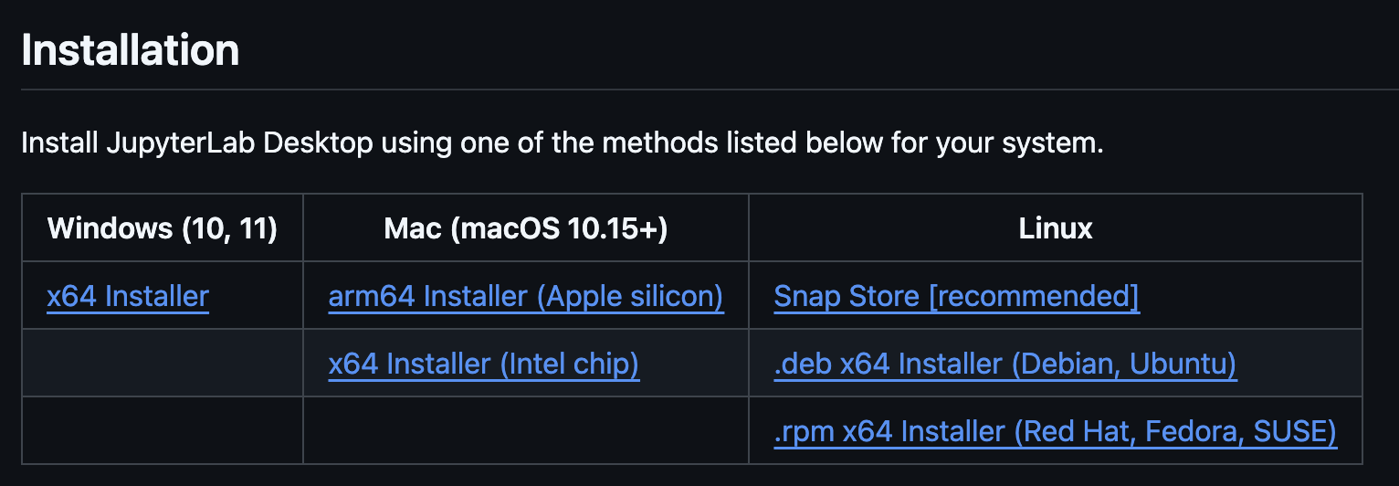




Which one to pick?
Newer M1, M2, M3 macs
Windows PC
Older macs, not M1/M2/m3
iPads or Chromebooks:
You’ll use Google Colab

Slide 37
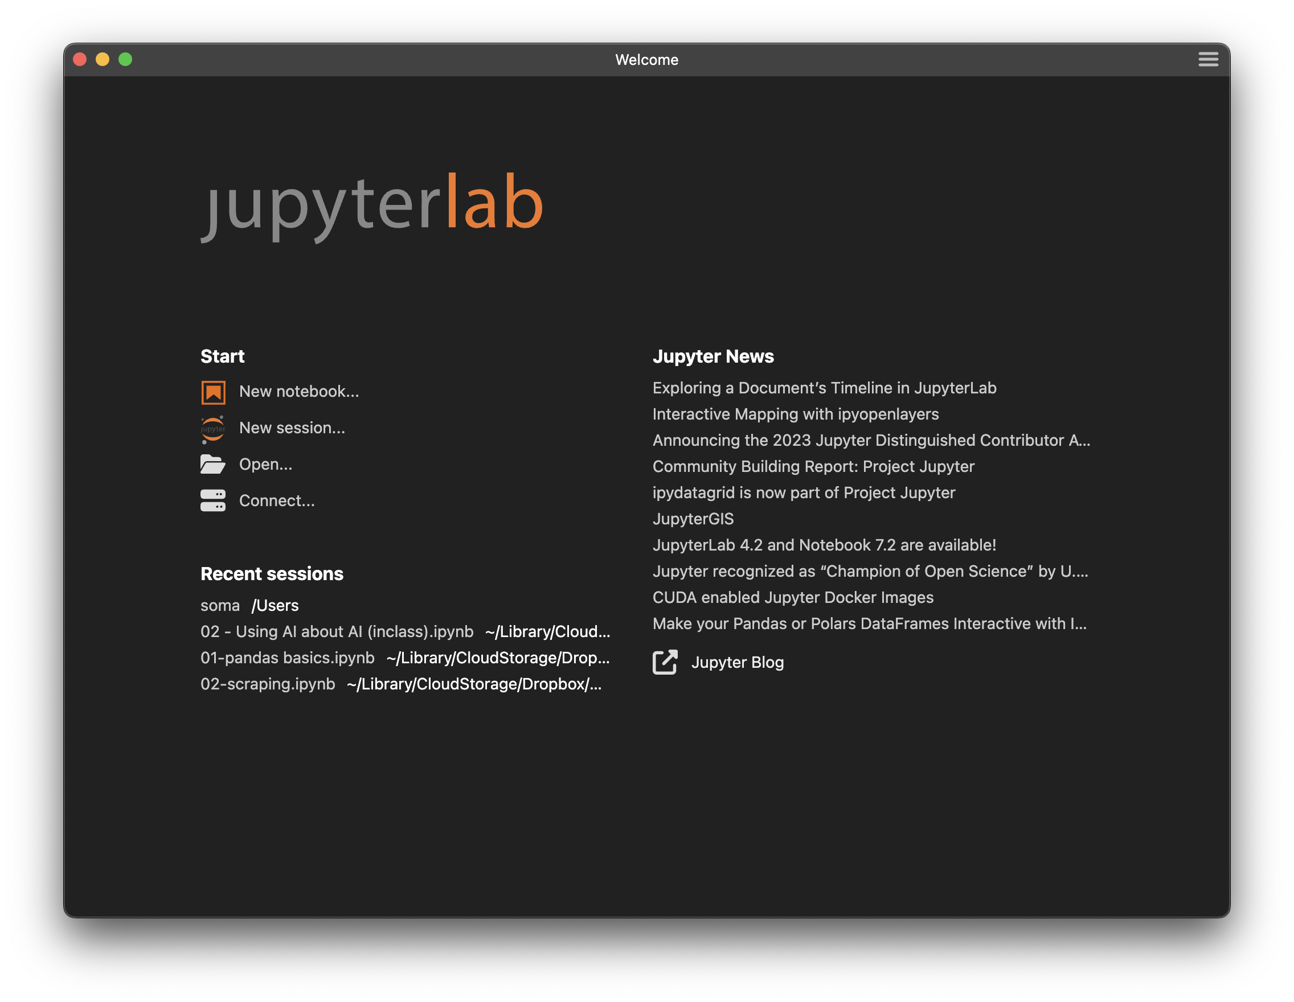
Installation
https://bit.ly/ds-jupyterlab
Download and run the installer
Security warning? Say yes!
After installation, open the JupyterLab Desktop app
Maybe it maybe will want to install Python: there will be a banner to click on the bottom.
Grey “New notebook?” Close, open again, look for Python install
You should see this

Slide 38
Excel vs. Python
Easy to get started
Easy to see results
Common in business environments
Easy to make mistakes
Difficult to install
Difficult to begin learning
Difficult to share with non-programmers
Everything is possible!

Slide 39
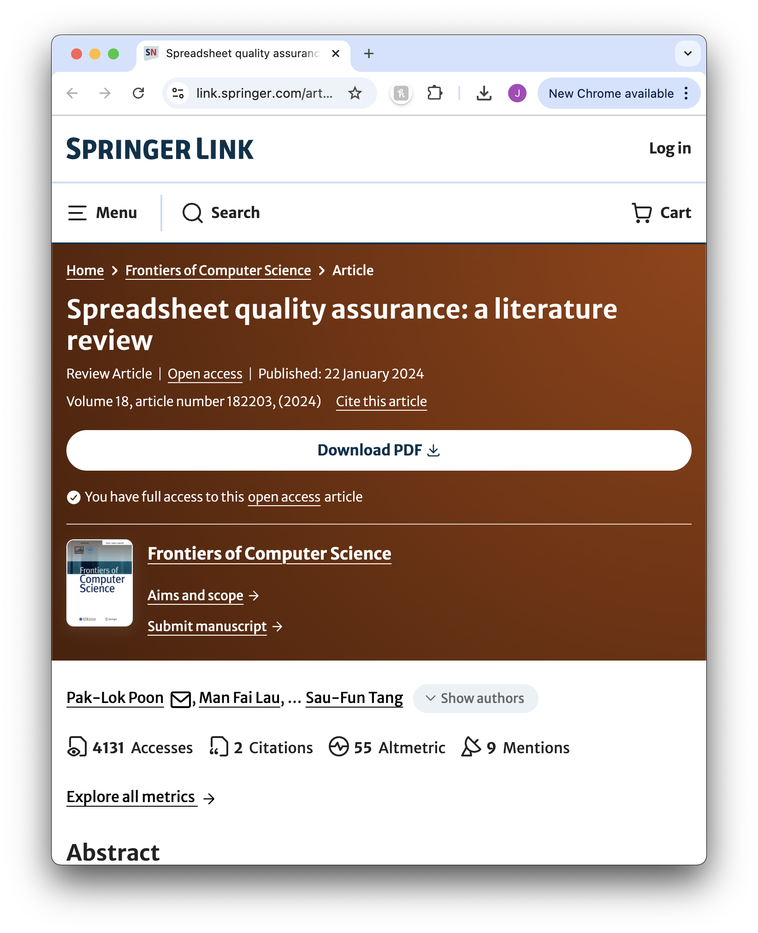
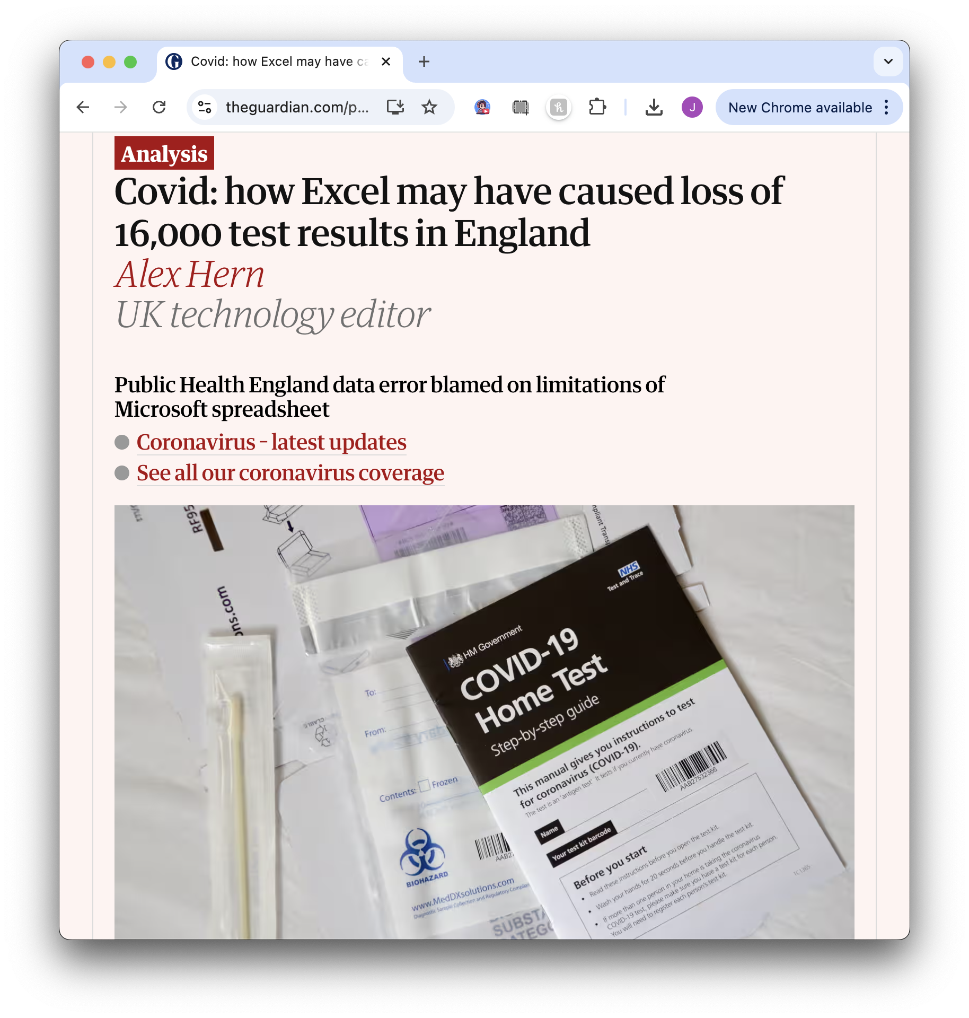
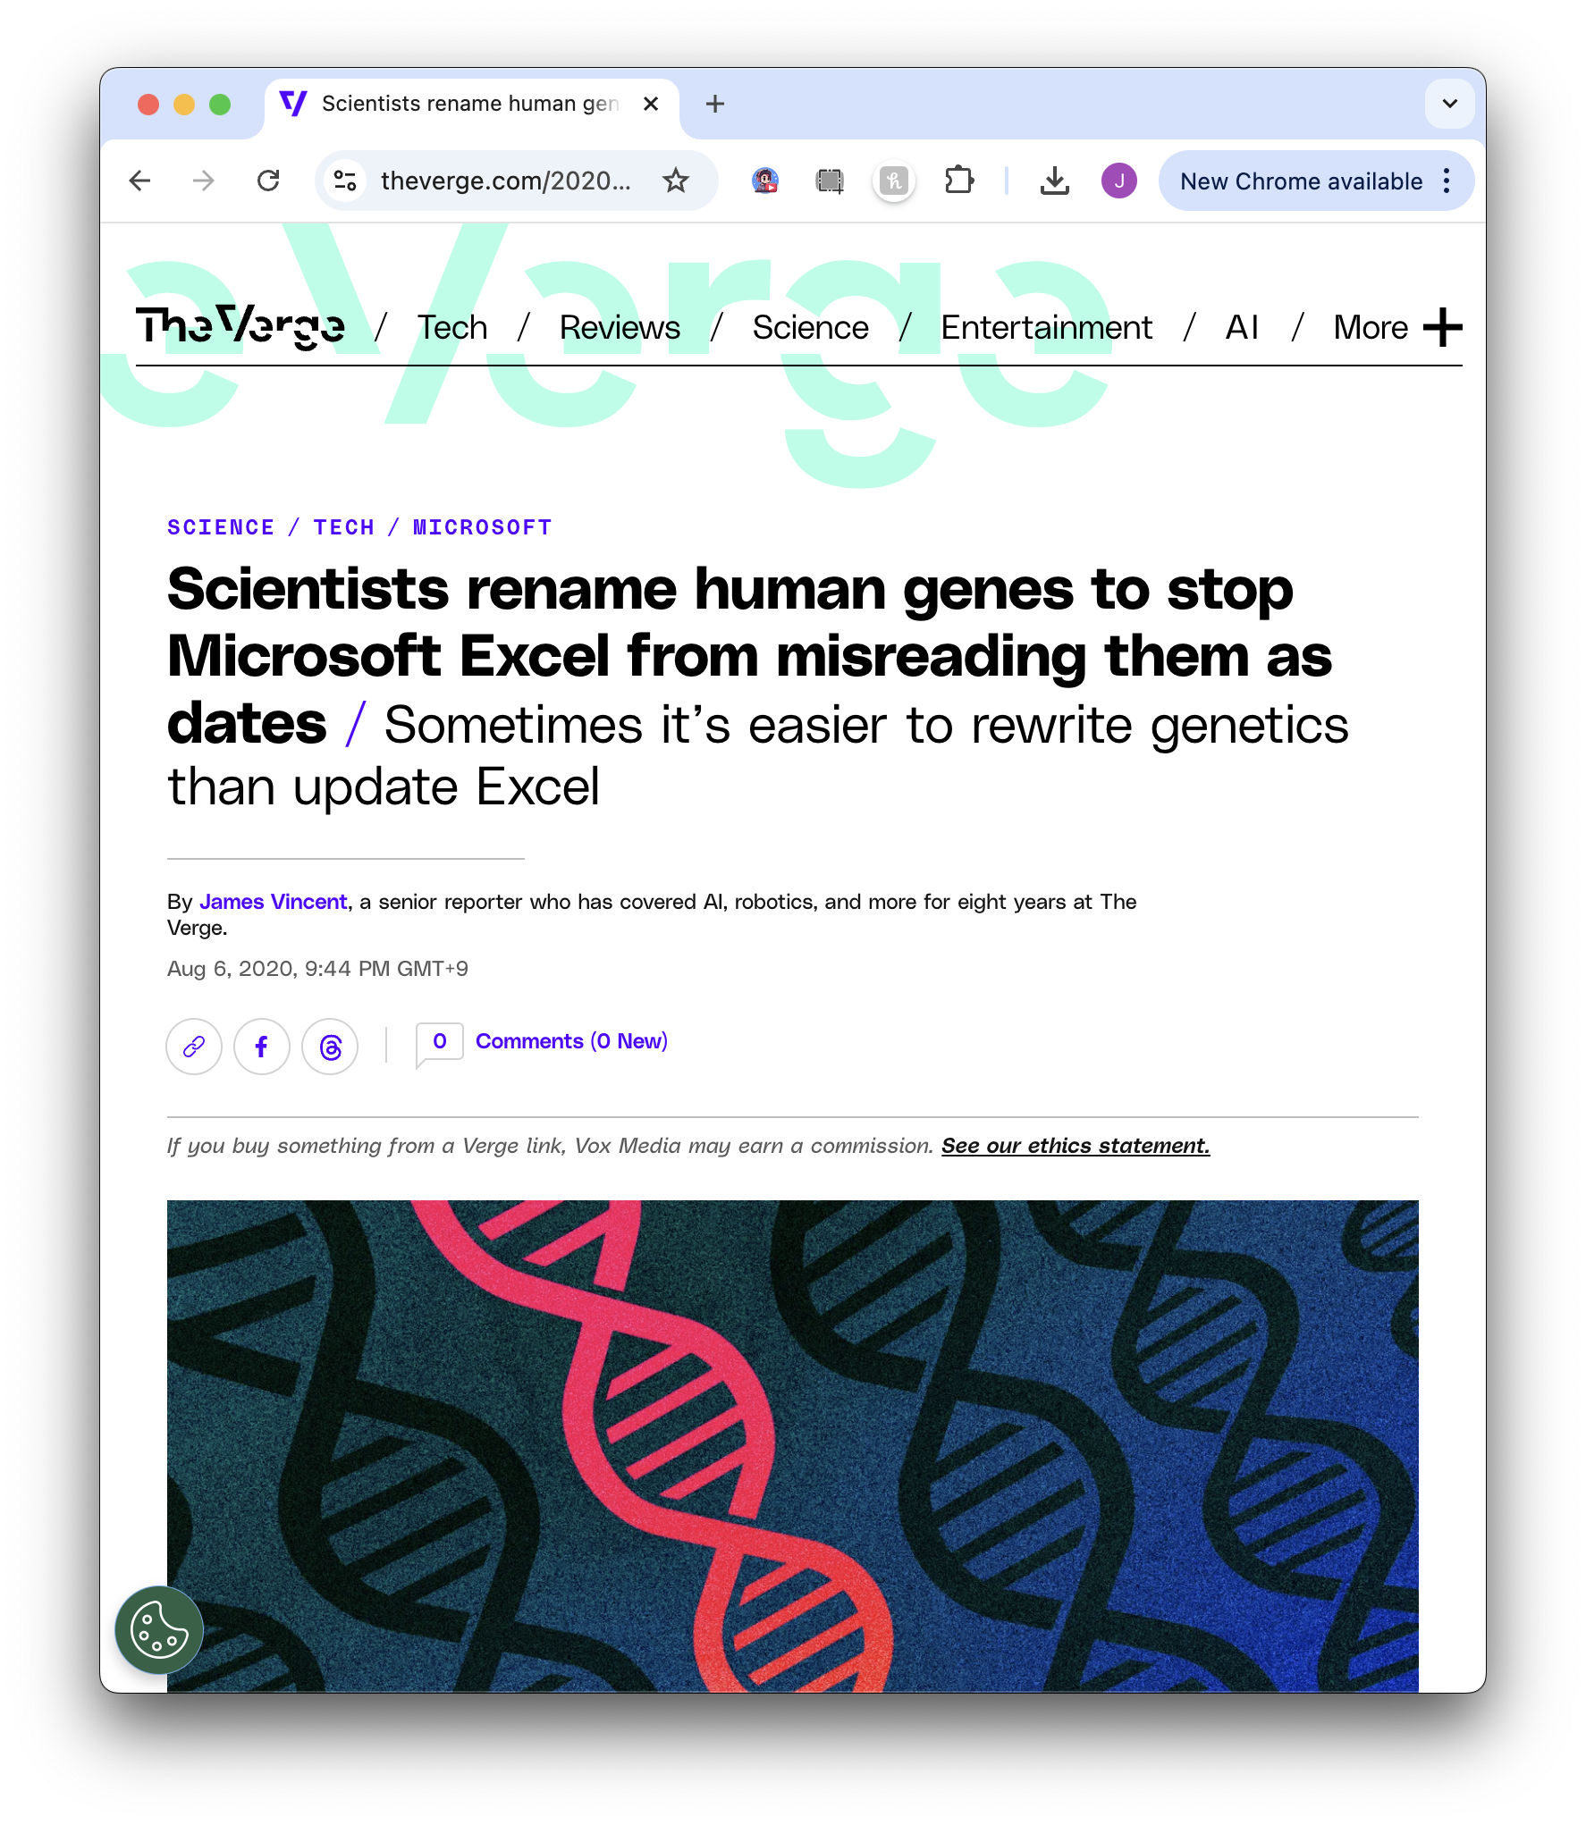
Problems with Excel
easy to have errors
data importing
row and cell limits

Slide 40
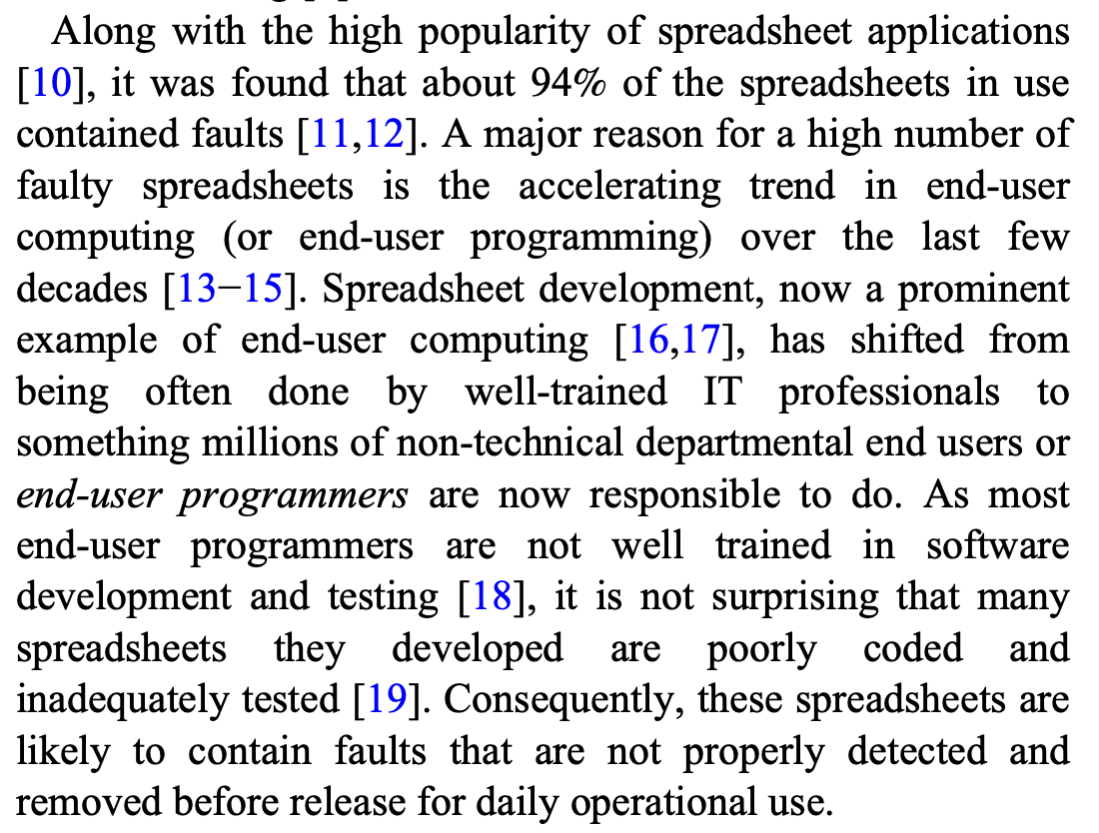
Excel errors
94% have faults!
From “Spreadsheet quality assurance: A literature review”

Slide 41
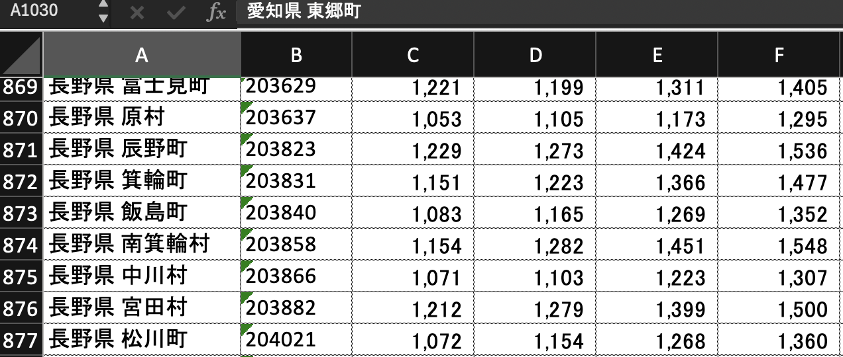
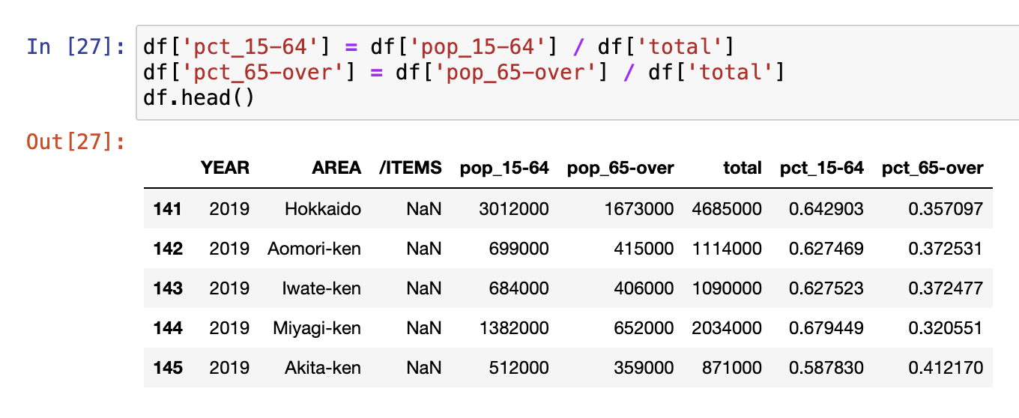



You can read Python
What is happening?
Easy to read

Slide 42
Visit https://bit.ly/ds-dojo-2024 for material
データ サイエンティスト
DOJO
Jonathan Soma
js4571@columbia.edu
Knight Chair in Data Journalism, Columbia University

Slide 43

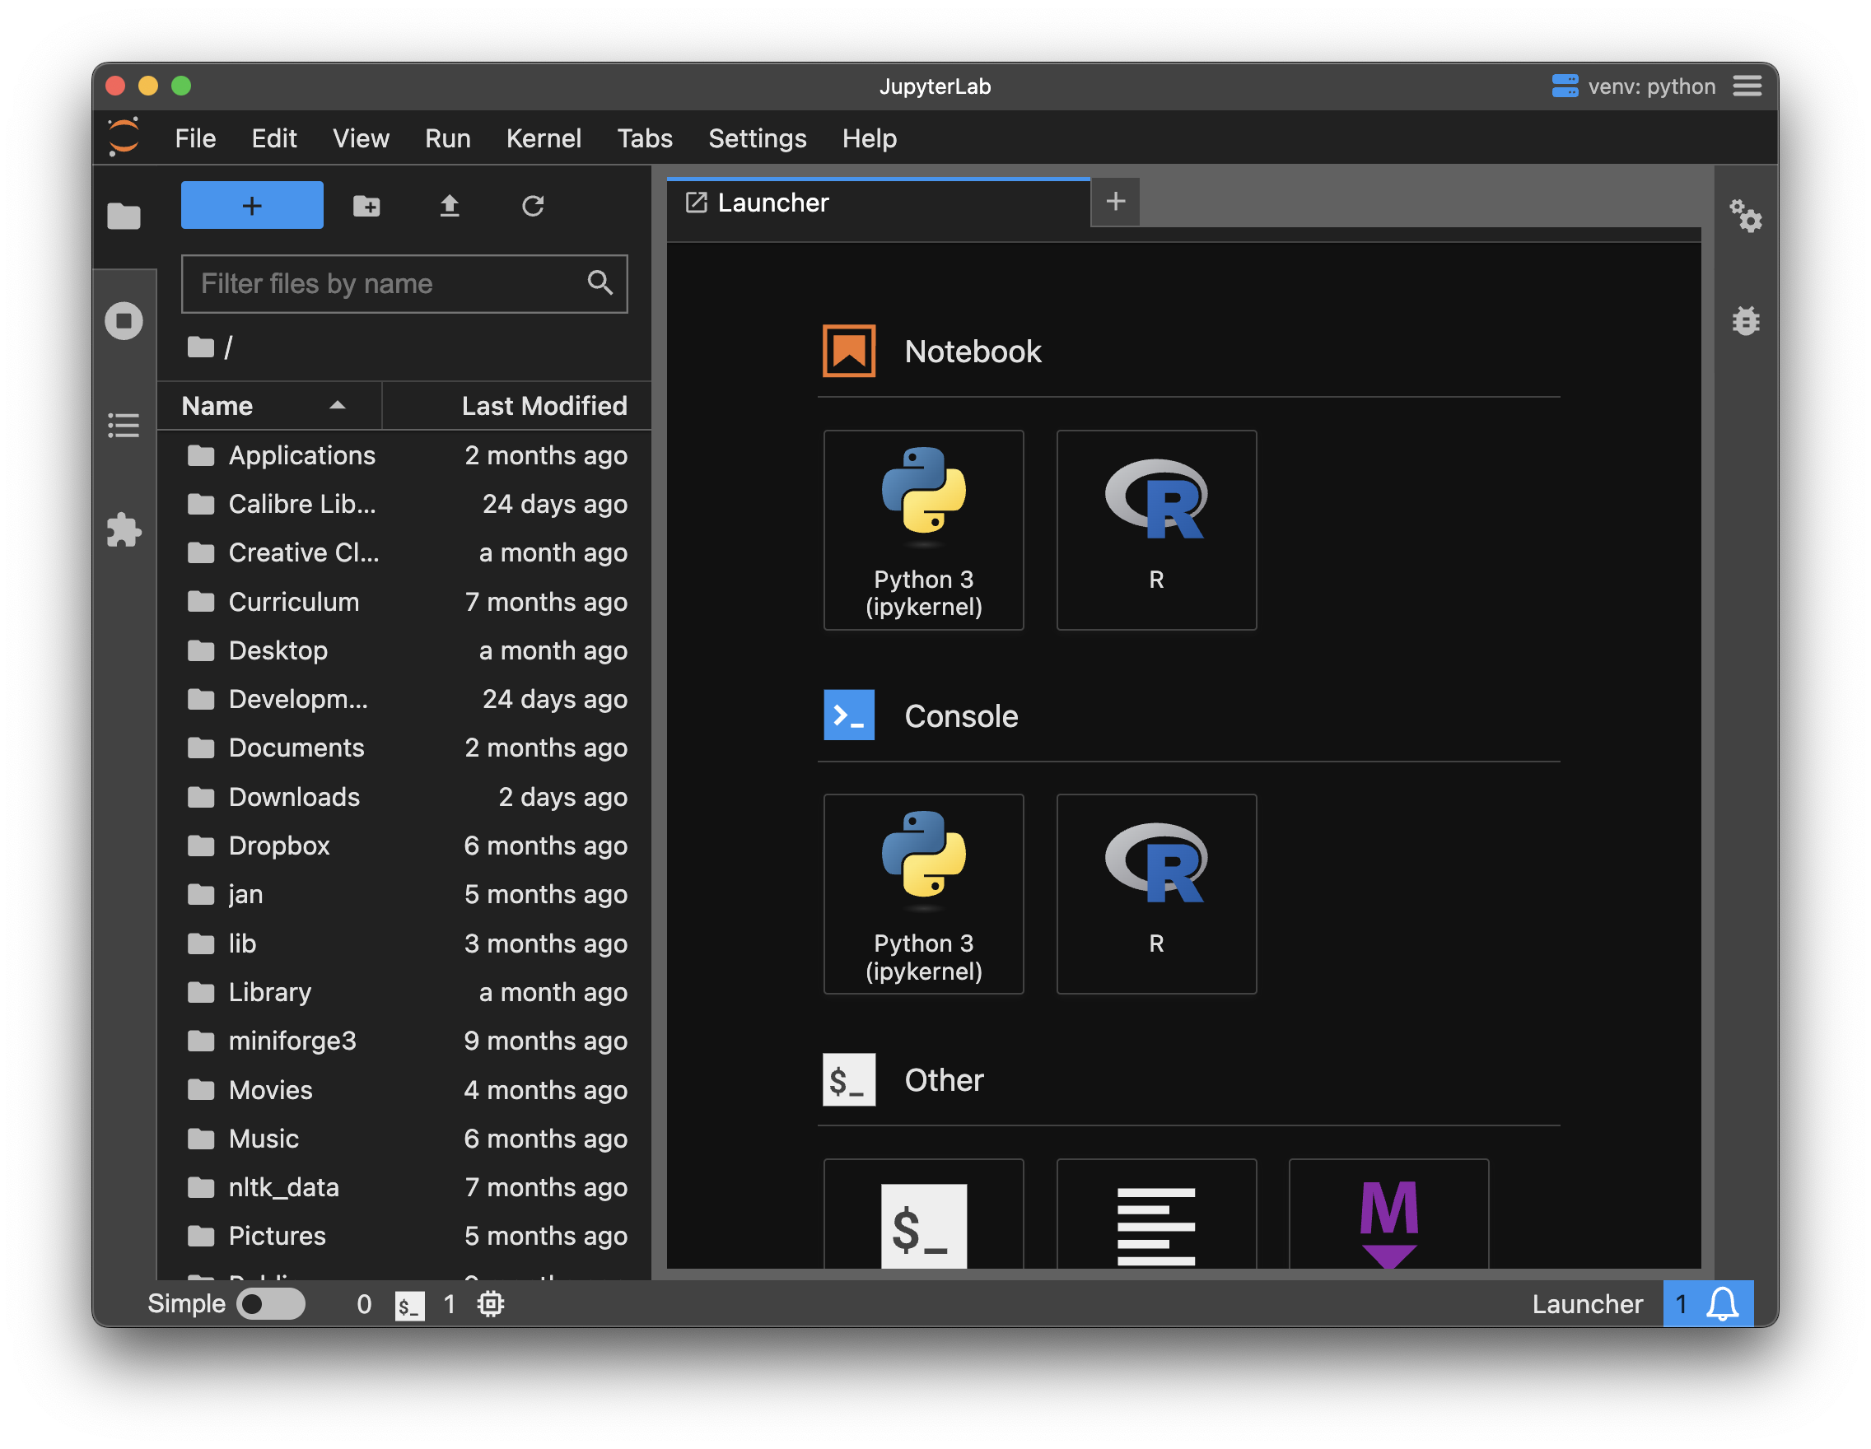




Create a new notebook
② Double-click Desktop
① Click “New session”
③ Click Python 3 under “Notebook”

Slide 44
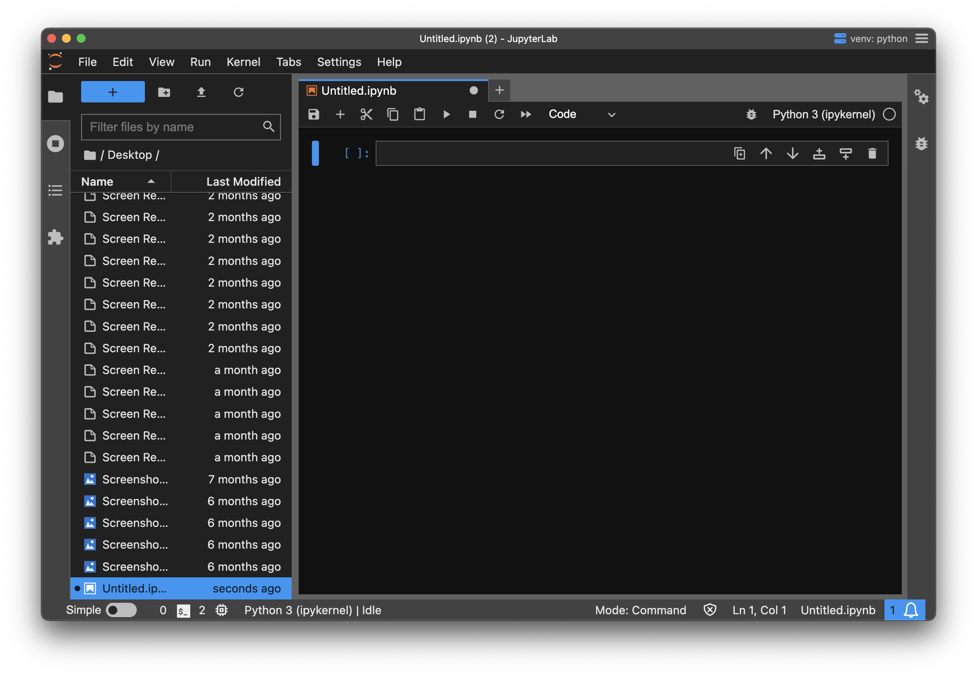











Slide 45
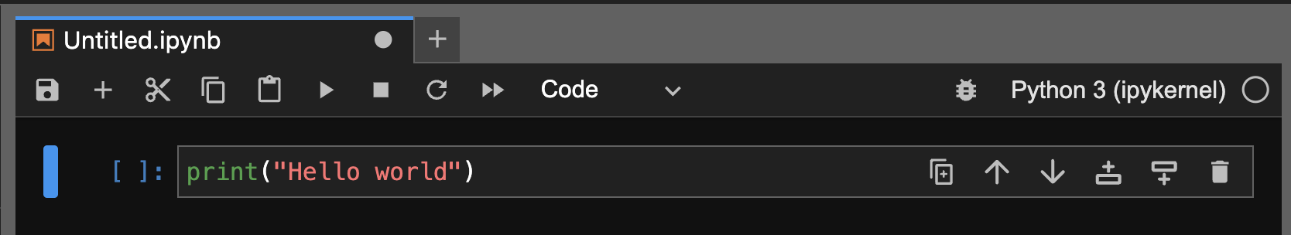
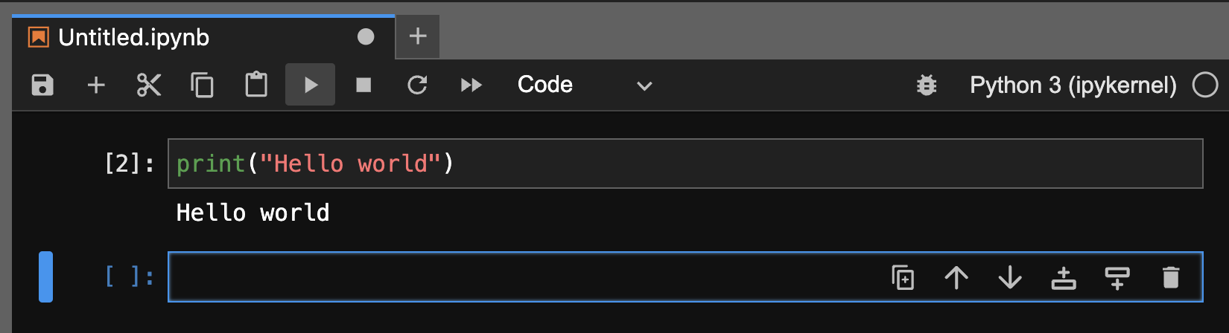


Press Play or Shift+Enter/Return
You should see this

Slide 46
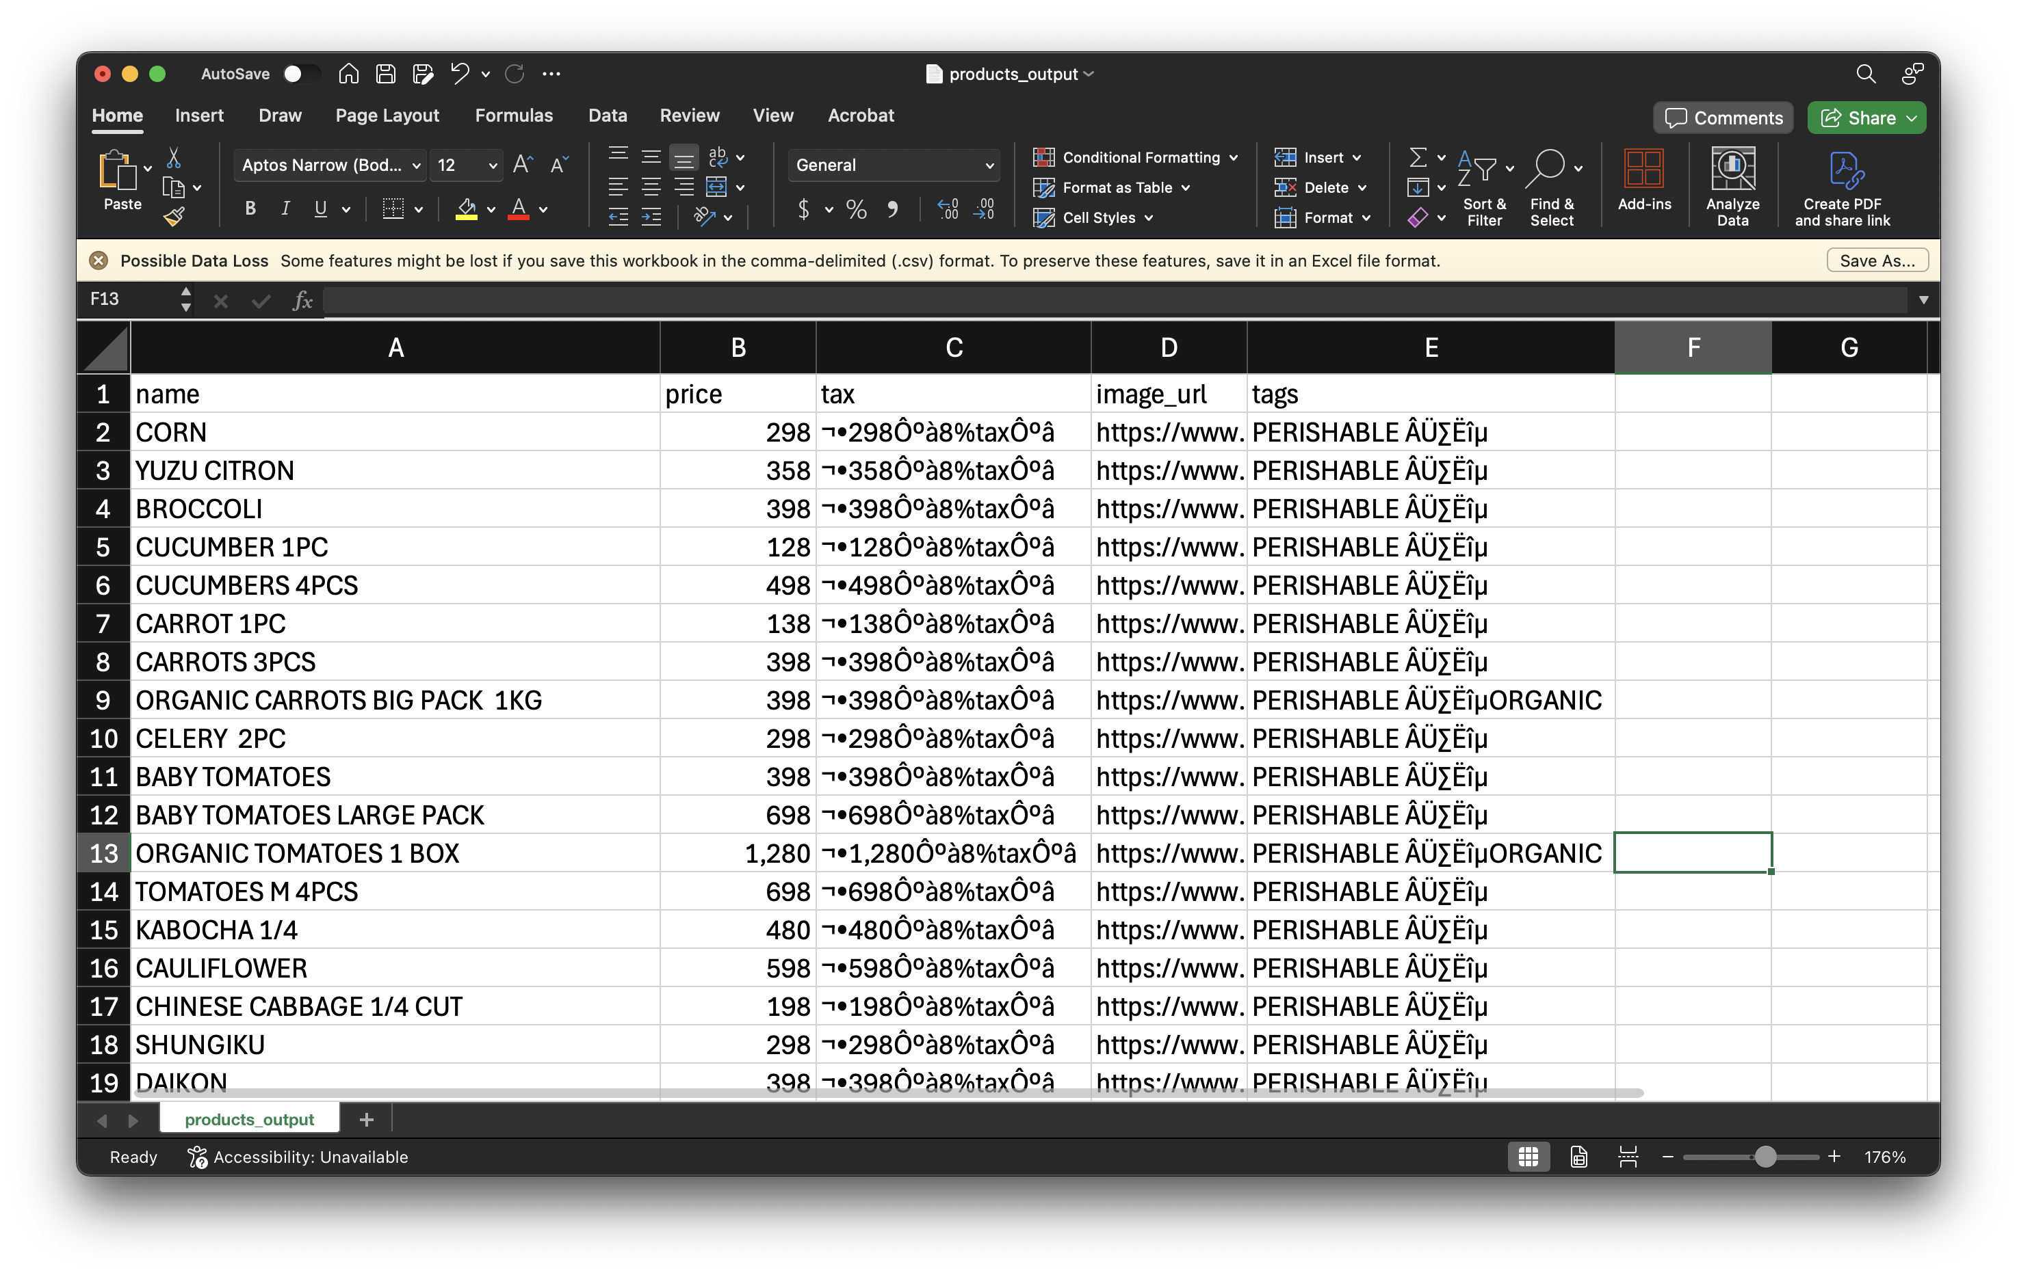
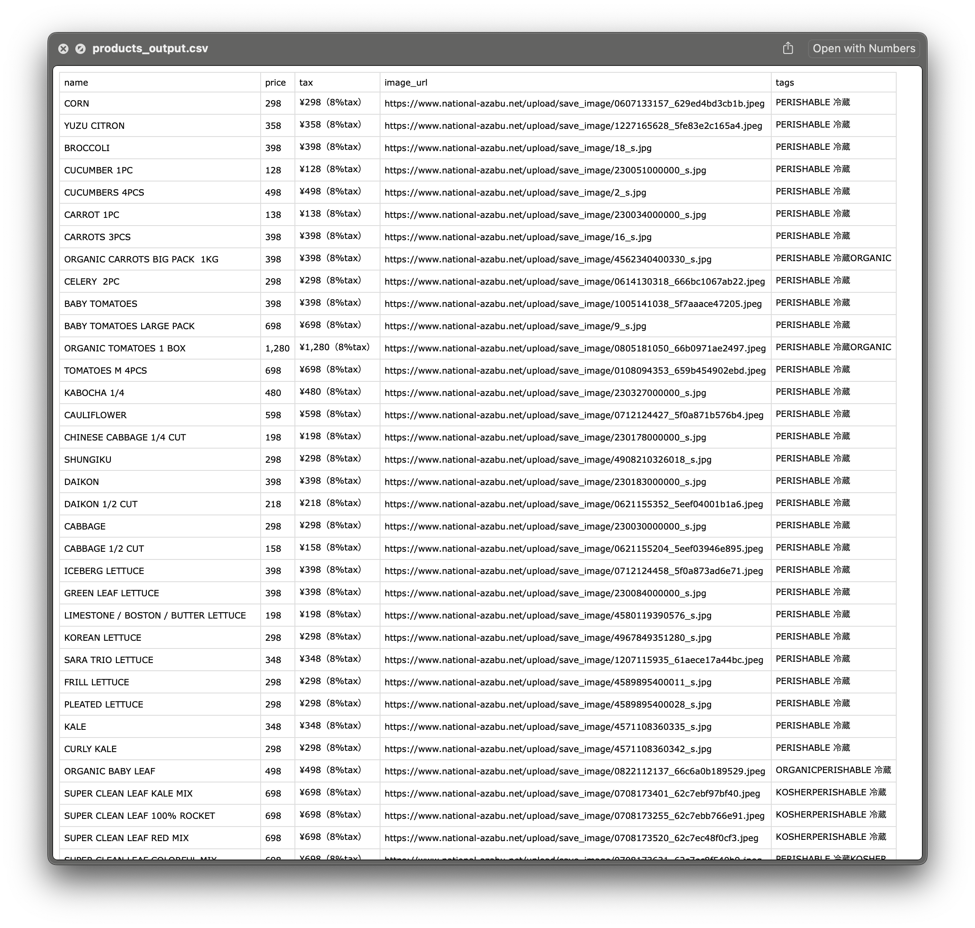
Character encoding

Slide 47
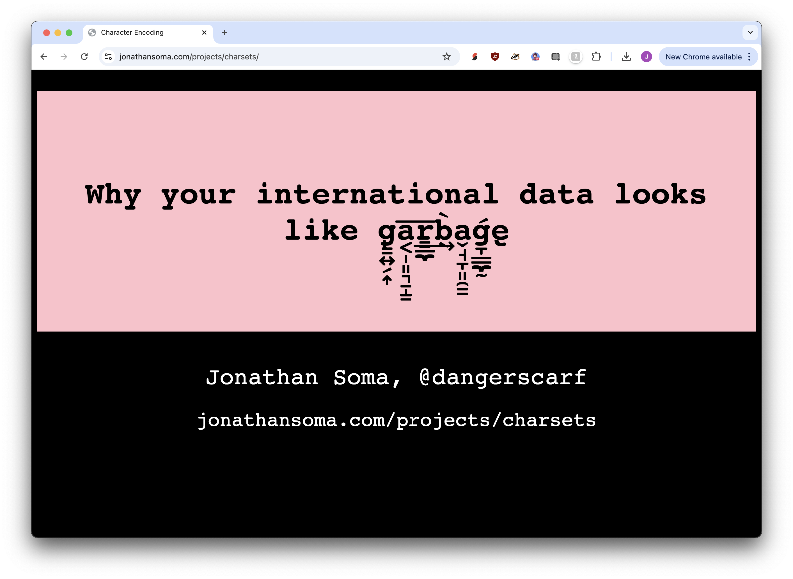
https://jonathansoma.com/projects/charsets/

Slide 48
Python basics
I hope it is review, but if not: that’s okay!

Slide 49

A tiny Python quiz
Don’t run the code, just think and try to answer the questions
Maybe easier on your computer than phone?
https://bit.ly/ds-dojo-python-quiz

Slide 50
Create a new notebook
② Double-click Desktop
① Click “New session”
③ Click Python 3 under “Notebook”

Slide 51
let’s do some work!
time to try out some Python

Slide 52
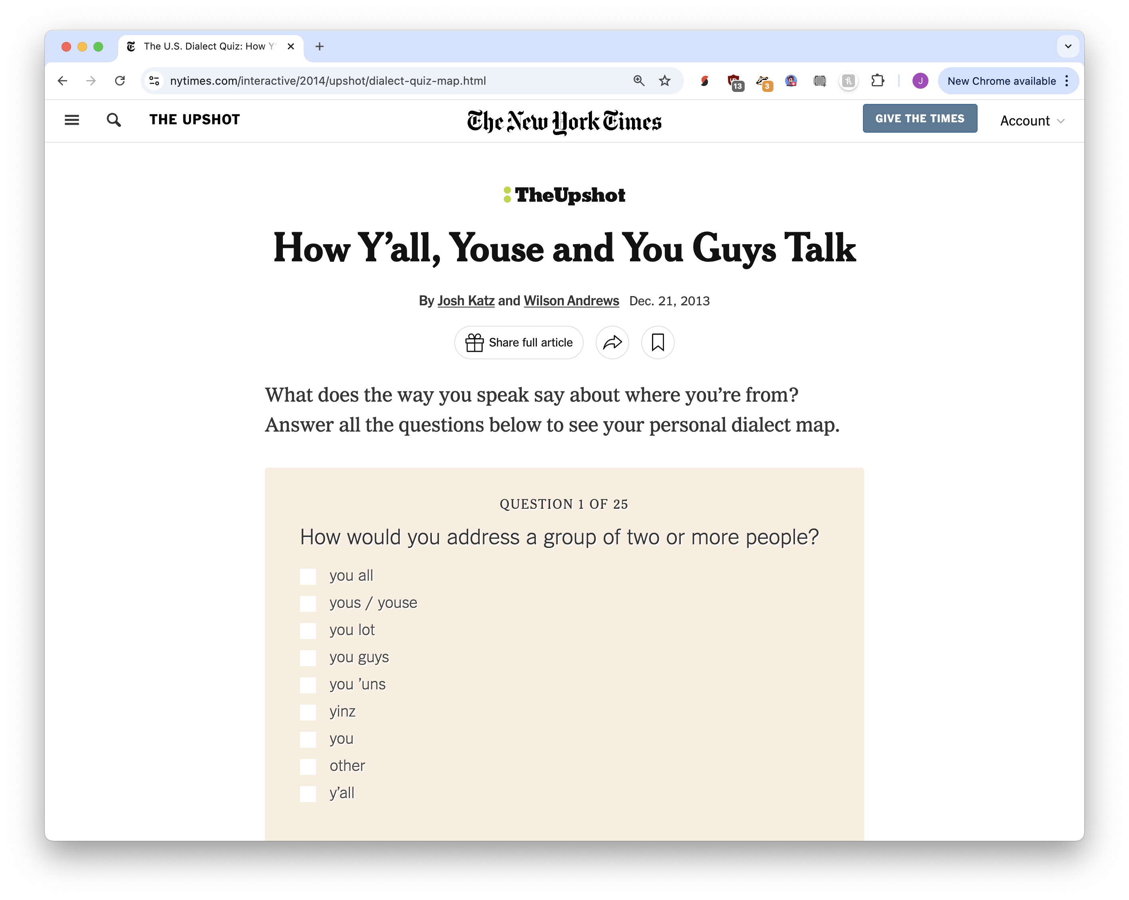
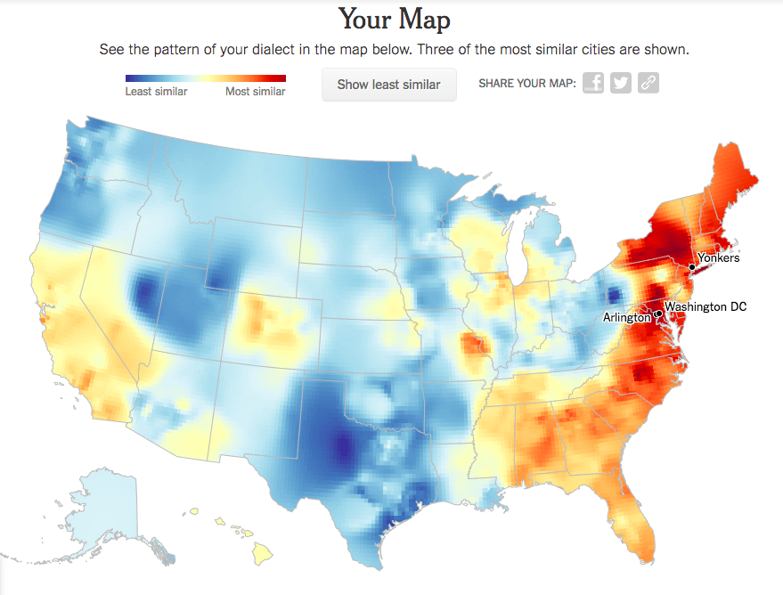
Building Products

Slide 53
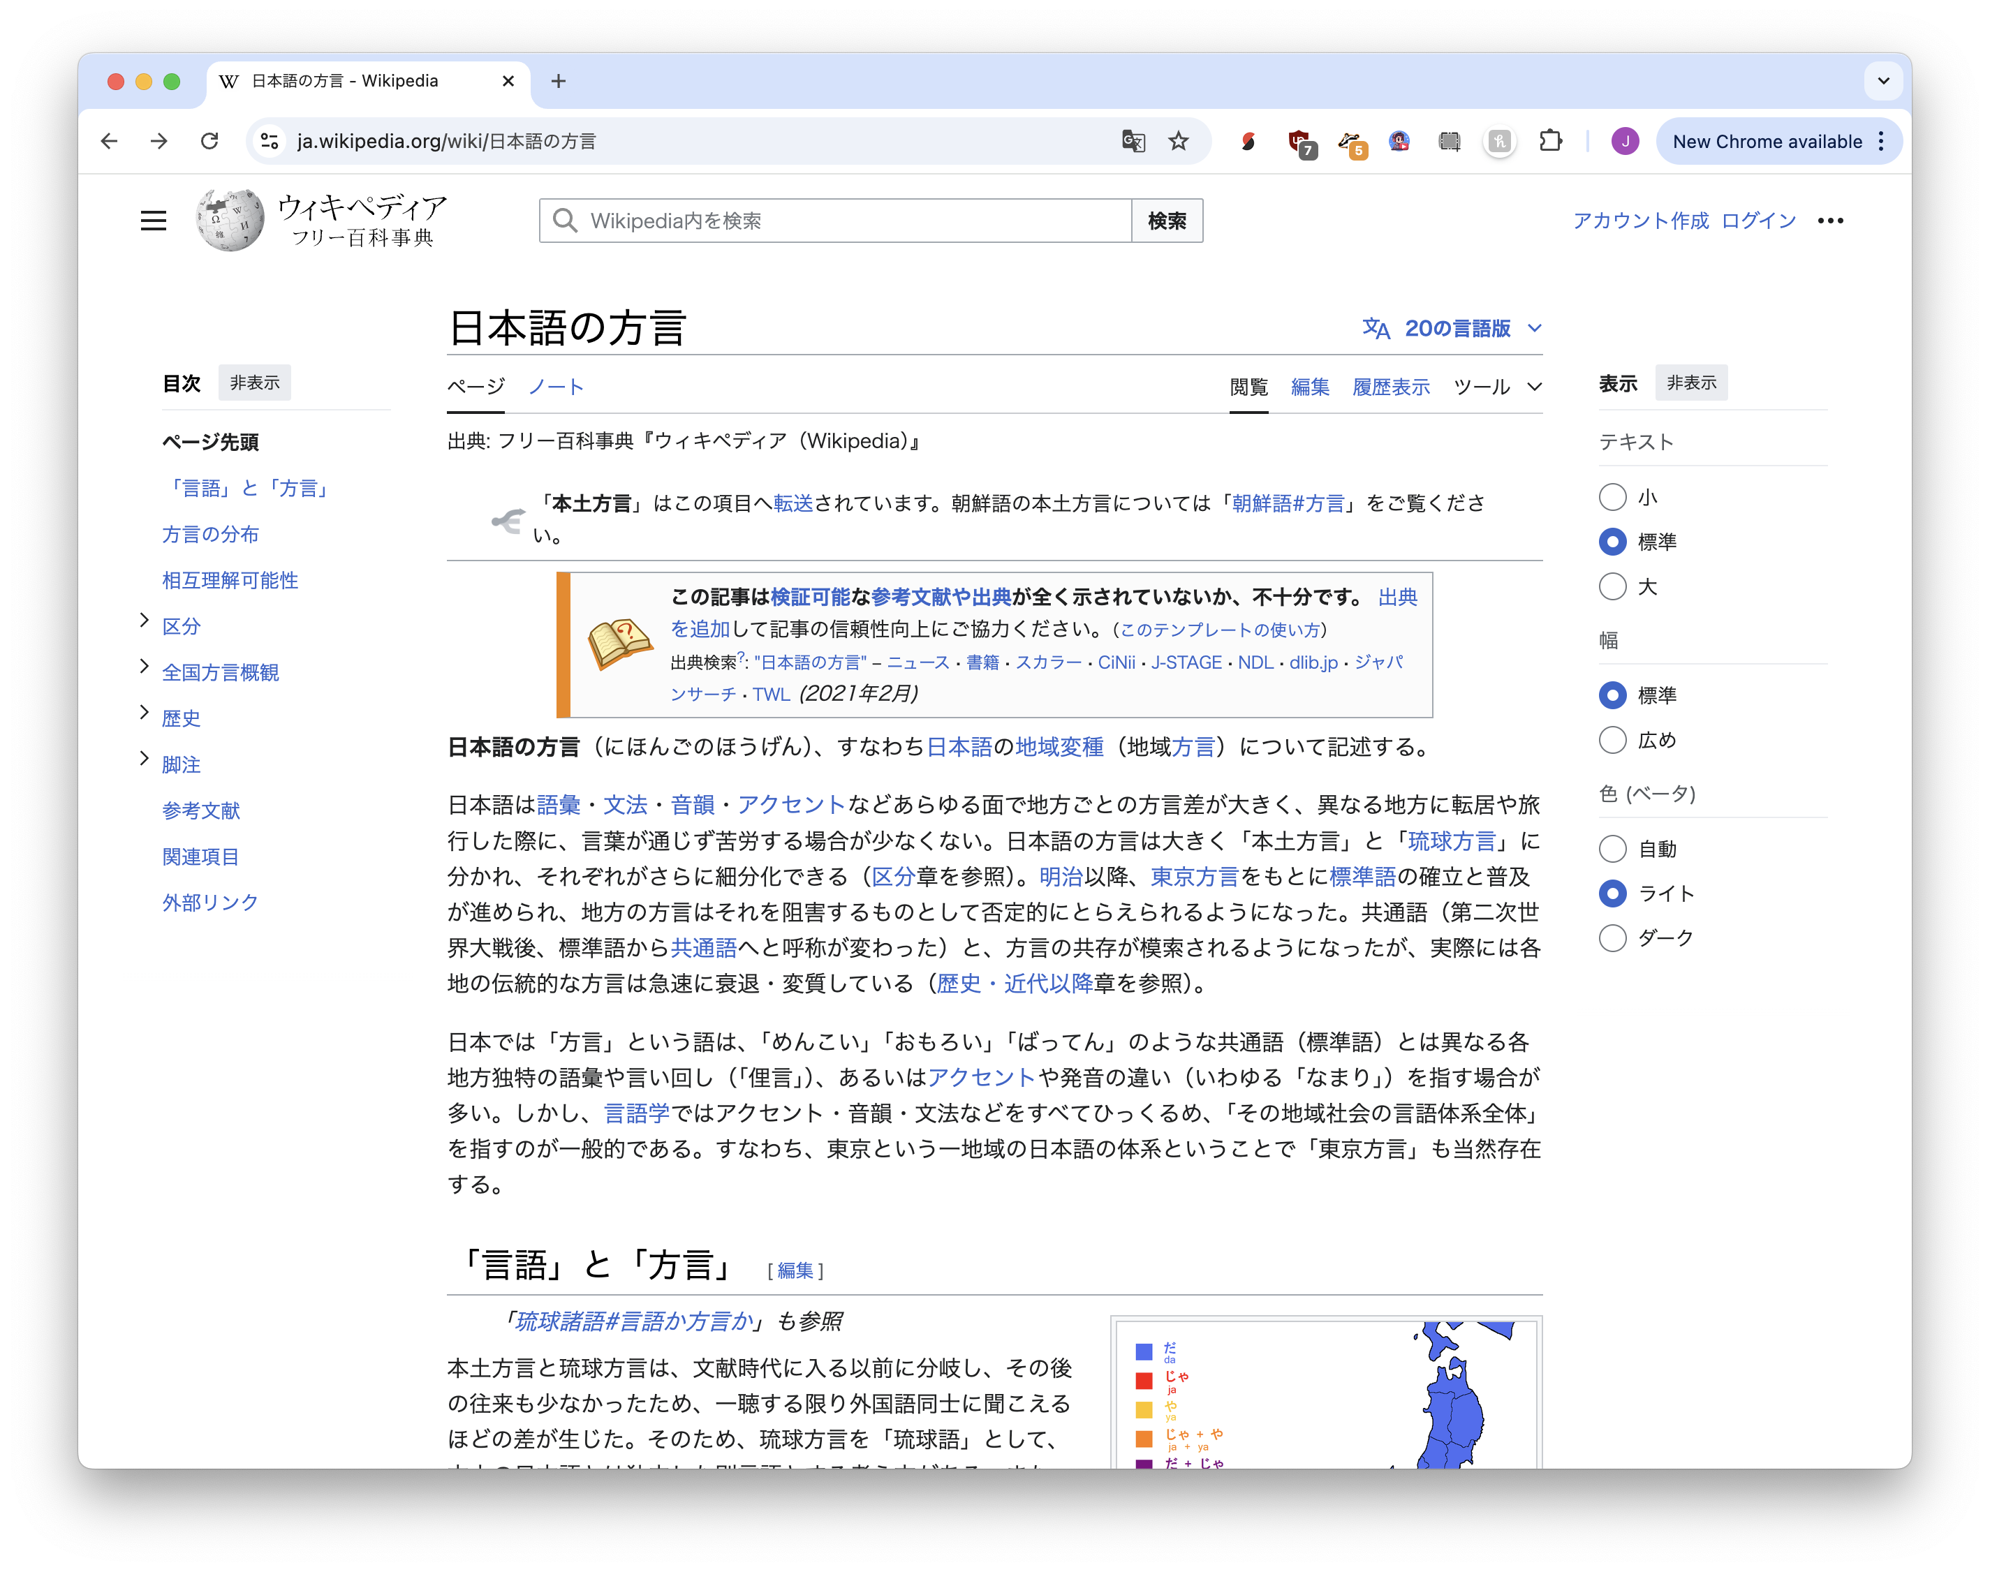

Can you build it?

Slide 54
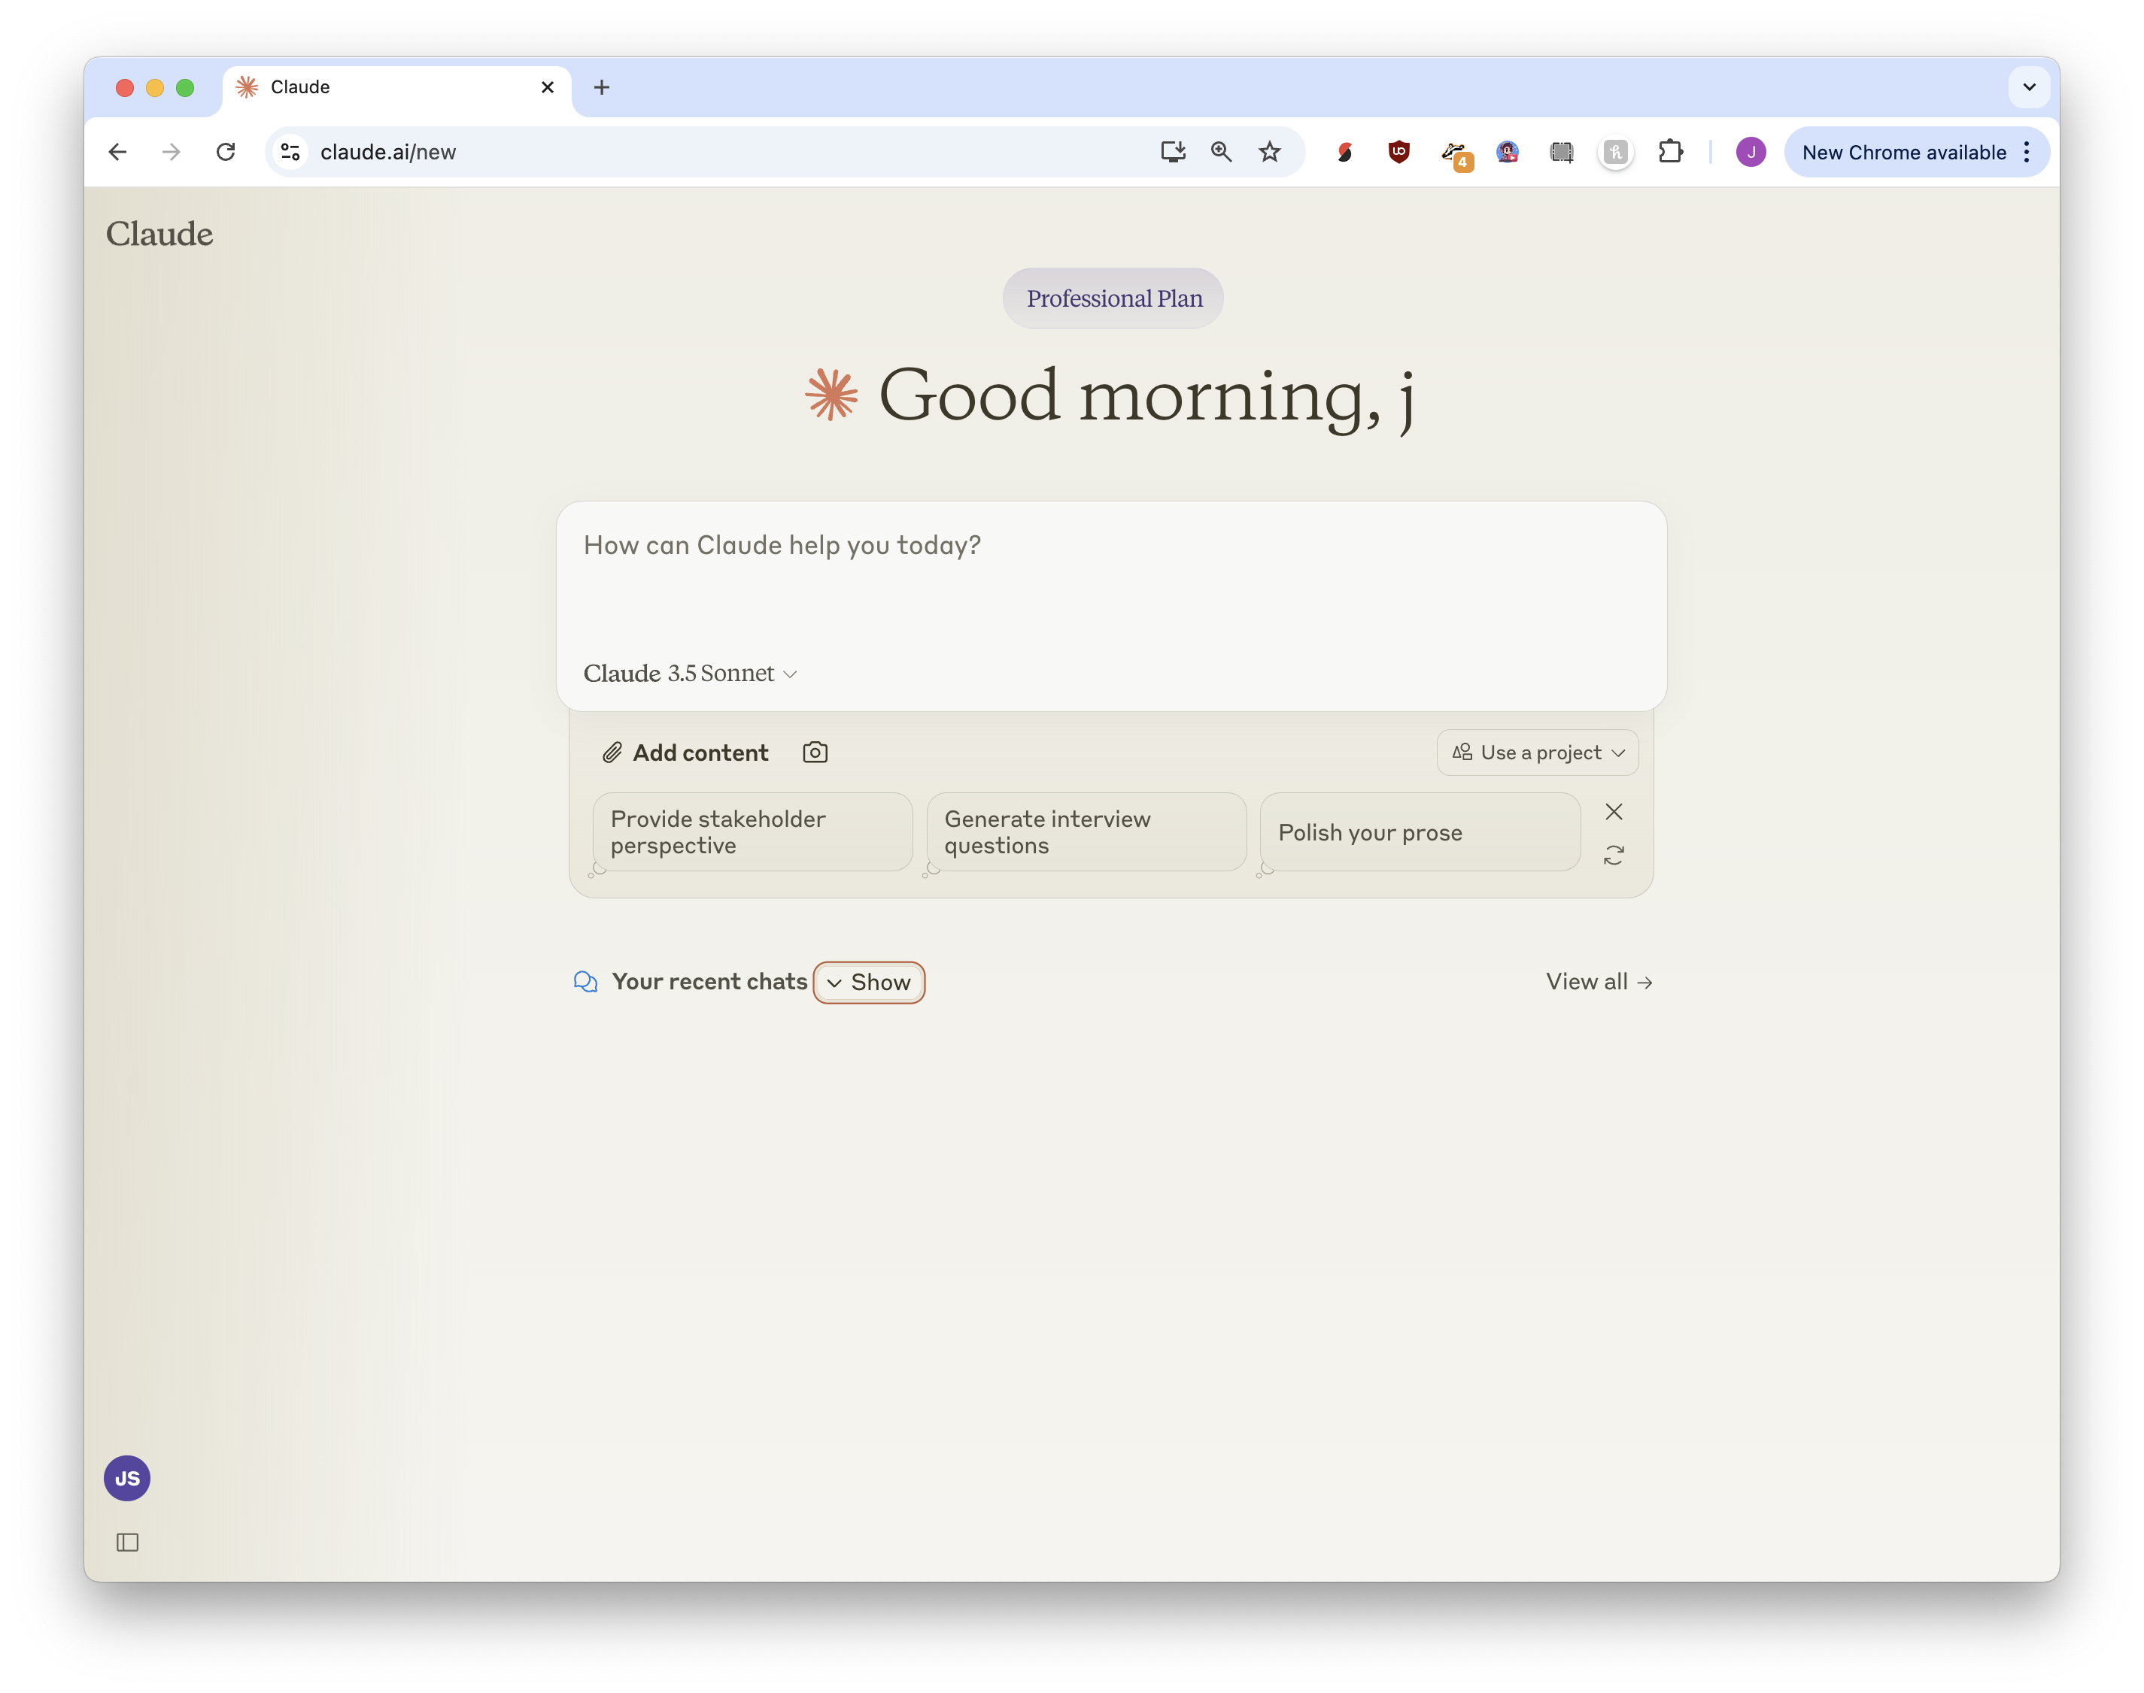
claude.ai

Slide 55
Visit https://bit.ly/ds-dojo-2024 for material
データ サイエンティスト
DOJO
Jonathan Soma
js4571@columbia.edu
Knight Chair in Data Journalism, Columbia University

